Slide 1


PRESENTATION BY TIMM KRUEGER | HOUSING ACTION ILLINOIS
Notes:
Good morning everyone and welcome to today’s webinar: Print Pieces That Get Results. This is the last training of the FPP-G 1 grant period, and I wanted to kick off today’s webinar by thanking you for attending these trainings! This started off as an experiment, and we’re glad that it has been well-received by each of you. We truly hope that these have helped improve your marketing efforts over the last year.

Slide 2


TODAY’S AGENDA
  SCIENCE LESSON
  BACK TO BASICS
  SPREADING AWARENESS
  MEASURING SUCCESS
PRESENTATION BY TIMM KRUEGER | HOUSING ACTION ILLINOIS
Notes:
For our last webinar, we’re going to begin by taking a look at the science behind visual communications and talk about why we do the things that we do in print marketing. Then, we’ll go over some simple basics of what you need to include for good marketing collateral, followed by how you can spread awareness for your organization in the most effective way. Finally, we’ll talk about how you can measure success, because print marketing is a lot different than digital marketing in that area.

Slide 3

EARLY BIRD REGISTRATION IS EXTENDED!
$50 off the full-price conference registration
Register by August 31 to save!
* TIP: You can use FPP-G training funds for registration
PRESENTATION BY TIMM KRUEGER | HOUSING ACTION ILLINOIS
Notes:
Now for a little housekeeping: Join us at the 2018 Housing Matters! Conference, which takes place October 25 and 26th down in Bloomington, Illinois. This year’s theme is “Leading the Way,” and will provide you with networking and educational opportunities to help you continue to lead your community’s efforts to protect renters, homebuyers, and homeowners. For those of you who missed yesterday’s announcement, we’ve extended early bird pricing! Be sure to register by August 31 to not only get $50 off your registration fees, but to also help spend down your remaining FPP-G 1 training dollars!

Slide 4

MEET THE PRESENTER
TIMM KRUEGER | COMMUNICATIONS & MARKETING CONSULTANT
HOUSING ACTION ILLINOIS
SMITHBUCKLIN
PEORIA HOUSING AUTHORITY
S&S PROPERTY MANAGEMENT
PRESENTATION BY TIMM KRUEGER | HOUSING ACTION ILLINOIS
Notes:
And lastly, I wanted to offer a little insight into why you should trust what I’m saying today! Throughout my career, I’ve used print materials in every size, shape, length, and format you can imagine to acquire and retain new customers, clients, and businesses. There are a lot of nuances with print marketing that you may not fully realize, and I’m excited to share my experience with you today!

Slide 5
SCIENCE LESSON
PRESENTATION BY TIMM KRUEGER | HOUSING ACTION ILLINOIS
Notes:
And with that, let’s get started! Just a reminder that you can ask questions at any time and we will get to them at the end of each section, or whenever it is most appropriate, which you may have after this section, where we take a little dive into some of the eye and brain science behind design.

Slide 6



SCIENCE LESSON
POLL: WHICH FLYER IS MORE APPEALING TO YOU?
A
B
Why is this more appealing?
PRESENTATION BY TIMM KRUEGER | HOUSING ACTION ILLINOIS
Notes:
Let’s start off with a poll: which of these flyers is most appealing to you?
[Poll | Show Results]
Ok, let’s see the results. It looks like pretty much everyone agrees that flyer B [advance] is the most appealing flyer of the two. [ADVANCE] It’s pretty easy to see why, right? Aesthetically, option B is cleaner, it looks updated, and it looks like it was professionally done. Even though both flyers have basically the same information, B was presented in a manner that works with how our brains process information, rather than against it. In fact, B was designed with psychology in mind. [ADVANCE]

Slide 7
SCIENCE LESSON
POLL: WHICH FLYER IS MORE APPEALING TO YOU?
B
Why is this more appealing?
PRESENTATION BY TIMM KRUEGER | HOUSING ACTION ILLINOIS
Notes:
Let’s start off with a poll: which of these flyers is most appealing to you?
[Poll | Show Results]
Ok, let’s see the results. It looks like pretty much everyone agrees that flyer B [advance] is the most appealing flyer of the two. [ADVANCE] It’s pretty easy to see why, right? Aesthetically, option B is cleaner, it looks updated, and it looks like it was professionally done. Even though both flyers have basically the same information, B was presented in a manner that works with how our brains process information, rather than against it. In fact, B was designed with psychology in mind. [ADVANCE]

Slide 8
SCIENCE LESSON
HUMANS HAVE SHORT ATTENTION SPANS
You have about eight seconds to get our attention
  Eye-catching
PRESENTATION BY TIMM KRUEGER | HOUSING ACTION ILLINOIS
Notes:
For example – humans have short attention spans; you’re lucky to get eight seconds of someone’s concentration. If you want someone to notice your work, it has to be eye-catching. The best way you can capture someone’s attention is with big, bold colors and beautiful images. But we don’t always have access to those, so another way of catching people’s attention is by asking a question, like I did in this flyer. Not only are you telling them that they’re not alone, you’re also telling them that this is a place they can learn how to solve their problem.

Slide 9
SCIENCE LESSON
THE BRAIN LOVES VISUALS
They’re processed 60,000 times faster than text
  Balanced
  Eye-catching
  Good use of color
PRESENTATION BY TIMM KRUEGER | HOUSING ACTION ILLINOIS
Notes:
That said, if you do have the ability to use a big, bold visual – do it! [A] The human brain processes visuals SIXTY THOUSAND times faster than text alone. That’s why you see a lot of infographics, like this, nowadays. They trick the brain into thinking it’s an image, and they use a combination or numbers, pictures, and words, to keep us interested in what’s being presented. They’re essentially working with our brain, instead of against it. [A]
Finally, our minds crave balance and hierarchy. When I created flyer B, I also reconfigured the information to work with how we’re used to seeing information displayed – with a header and a sub-header. This is called the hierarchy of text, and it simplifies how information is perceived by our mind. There is a consistent flow to the text in flyer B, whereas in flyer A the information feels like it’s out of place – there’s even a random bit of text hanging out on the right side, which throws off the balance.
So this is all great information, but I’m sure you’re asking yourself: does any of this actually matter? Are people really analyzing flyers that much, especially if they’re barely looking at them? Well here’s a practical example of how designers use these in the real world, and it may not be what you think [A]

Slide 10
SCIENCE LESSON
…AND SIMPLICITY
THE BRAIN LOVES VISUALS
Cognitive fluency » Ease, order, hierarchy
  Balanced
  Eye-catching
  Good use of color
PRESENTATION BY TIMM KRUEGER | HOUSING ACTION ILLINOIS
Notes:
That said, if you do have the ability to use a big, bold visual – do it! [A] The human brain processes visuals SIXTY THOUSAND times faster than text alone. That’s why you see a lot of infographics, like this, nowadays. They trick the brain into thinking it’s an image, and they use a combination or numbers, pictures, and words, to keep us interested in what’s being presented. They’re essentially working with our brain, instead of against it. [A]
Finally, our minds crave balance and hierarchy. When I created flyer B, I also reconfigured the information to work with how we’re used to seeing information displayed – with a header and a sub-header. This is called the hierarchy of text, and it simplifies how information is perceived by our mind. There is a consistent flow to the text in flyer B, whereas in flyer A the information feels like it’s out of place – there’s even a random bit of text hanging out on the right side, which throws off the balance.
So this is all great information, but I’m sure you’re asking yourself: does any of this actually matter? Are people really analyzing flyers that much, especially if they’re barely looking at them? Well here’s a practical example of how designers use these in the real world, and it may not be what you think [A]

Slide 11
SCIENCE LESSON
WHO’S EVER SEEN A MENU LIKE THIS?
The science behind the design
PRESENTATION BY TIMM KRUEGER | HOUSING ACTION ILLINOIS
Notes:
I know a lot of times it can feel like menus are an after thought, or that they prioritize form over function, but not only is it in a restaurant’s best interest to follow the principles of design, they actually use them to help guide you to menu items that will give them the most profit. They’ll use words like “house special” or put seemingly random boxes around menu items, like they have on screen, to capture your attention and draw your eye to what they want you to see.
And so my point in telling you all of this is not because I love menus and food – although I do – but it’s actually because I wanted to show you a practical use of the principles that I just talked about. There are certain parts of marketing, or really any creative field, that are subjective and are all about personal preference. But there are core principles, rooted in science, which, when applied correctly, will help you better market your organization and services, so that you can reach as many people in your community as possible.

Slide 12
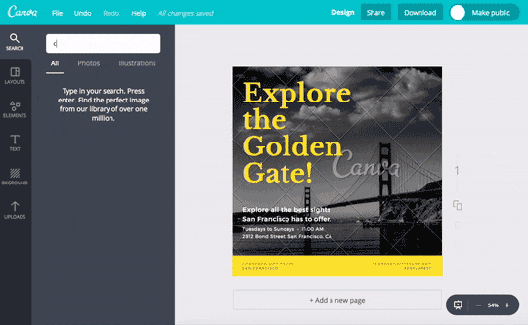
SCIENCE LESSON
TIP: Tools like PowerPoint or Canva are more powerful and easier to use than Word or Publisher
PRESENTATION BY TIMM KRUEGER | HOUSING ACTION ILLINOIS
Notes:
And one the best and most cost-effective ways you can create beautiful flyers, brochures, postcards – you name it – is Canva. I’ve been talking about Canva all year, but it really is one of the most powerful and easy to use tools out there, like you can see in this gif. Programs like Word or Microsoft Publisher can be clunky or difficult to create with, whereas Canva was designed to create flyers in the 21st century. Now, if Canva seems a little intimidating to you, they have a lot of tutorials on their website, and you could learn how to use it really well in just a few days.
Another great option is PowerPoint. PowerPoint’s layout makes it easy to move images around and place text, plus it will also guide you and tell you if things are perfectly centered, which is a functionality that Word doesn’t offer. So as we transition out of the science section and into our next section, keep these principles in mind.

Slide 13
BACK TO BASICS
PRESENTATION BY TIMM KRUEGER | HOUSING ACTION ILLINOIS
Notes:
As we enter the next section, I’ll take a few seconds to see if anyone has any questions about the science behind print designs.
Alright, let’s more into the next section, Back to Basics. In this section, we’re going to explore the steps you need to take when you are creating content. Just like in all things, having a good understanding of the basics will set you up for consistent success.

Slide 14
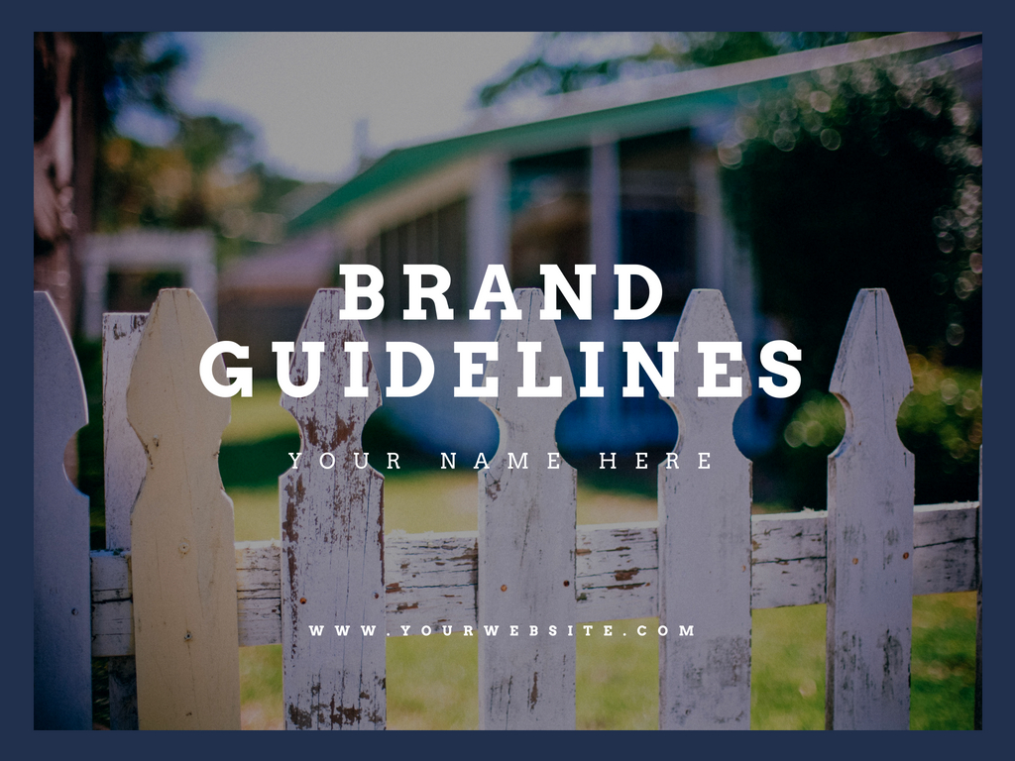
BACK TO BASICS
BRAND CONSISTENCY
Your organization’s visual signature
Why be consistent?
  Humans crave it
  Strong brand voice » more effective marketing in the future
How do you do it?
RESOURCE: Style Guide Template
PRESENTATION BY TIMM KRUEGER | HOUSING ACTION ILLINOIS
Notes:
We’ve all heard that saying “practice makes perfect.” When I was a young gymnast, one of my coaches would always say “practice doesn’t make perfect – perfect practice makes perfect.” Marketers are humans, too, and we make mistakes. One way of avoiding those mistakes is by having a guide that lets us be consistent. In our industry, that’s called a style guide, or branding guidelines. This is basically a rule book that tells you what you can and cannot do when it comes to making marketing materials for your organization.
Humans literally crave consistency, especially in marketing. It’s one of those things that, when done correctly, we don’t notice unless we’re looking for it. But, when things are inconsistent, we start to perceive that company or organization as disorganized, which makes us trust them and their services less. Visual consistency also lends to your brand – and yes, you are a brand! – having a stronger voice. Each time you create a piece of collateral that is consistent with your previous materials, it strengthens that voice, which means your marketing will be stronger, too.

Slide 15
BACK TO BASICS
BRAND CONSISTENCY
PRESENTATION BY TIMM KRUEGER | HOUSING ACTION ILLINOIS
Notes:
Style guides have two big benefits – first, it helps new employees ensure that they can easily learn about who your organization is, how you maintain your visual identity, and any other technical aspects that might be difficult to explain. There’s a lot of turnover in nonprofits, and it is sometimes very easy to tell when an organization had someone with a great eye for design versus when they didn’t. Your organization’s marketing materials shouldn’t be dependent on who works there – they should always be consistent!
External contractors, like printers and designers, also really benefit from style guides. They’re used to seeing these, and it allows them to learn about who you are easily so they can jump into working with you without having to ask millions of questions that you may or may not have firm answers to.

Slide 16
BACK TO BASICS
BRAND CONSISTENCY
Your organization’s visual signature
What goes in here?
  Brand colors
  Fonts
  Logo usage
  Tone of voice
  Mission/vision
  Consistent language
RESOURCE: Style Guide Template
PRESENTATION BY TIMM KRUEGER | HOUSING ACTION ILLINOIS
Notes:
Your organization’s style guide should include your brand colors – these are usually the two or three colors that are in your logo – and they’ll be written in the color codes that graphic designers use to find colors on the color wheel. Next, it’ll have all the fonts that are acceptable to use, as well as any spacing requirements that may exist for that. It’ll also have specific direction for how your logo can and cannot be used, as well as any rules you may have for your organization’s tone of voice and any language you may or may not use. Remember, the point of this is so that anyone can pick it up and know how to create a piece of collateral for you and your organization.
As a resource this month, we’ve created a style guide template for you that you’ll be able to easily enter in information that your organization will need for future use. However, it’s pretty bare bones, and so for those of you who would like to have an in-depth brand guidelines book created, please email me! I’d love to be able to help you create this valuable document for your organization.

Slide 17
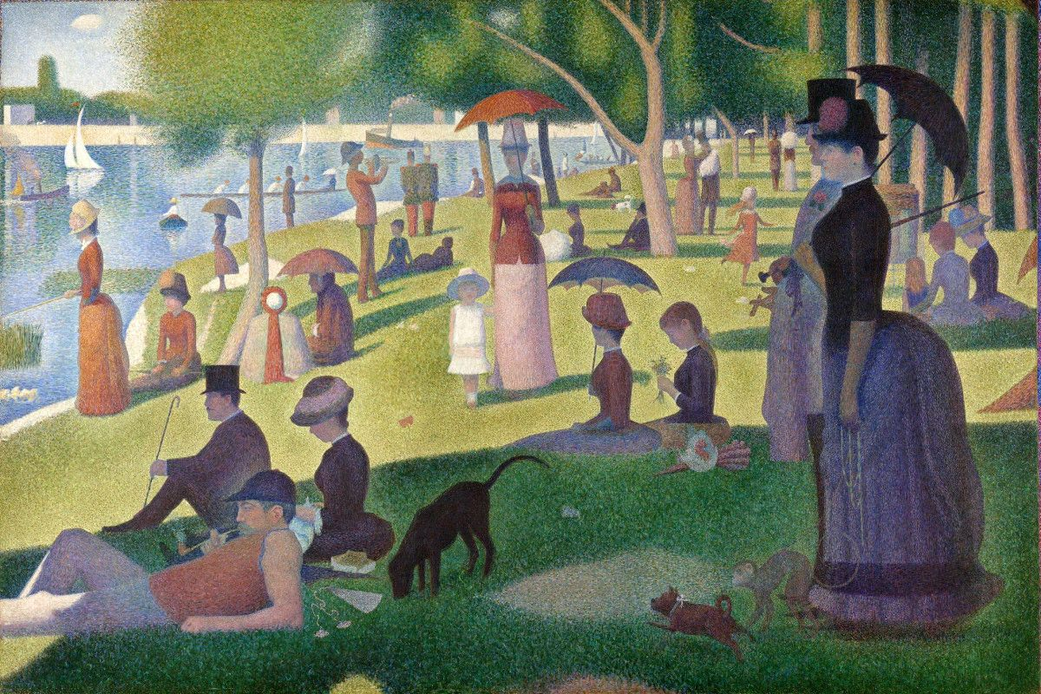


BACK TO BASICS
IMAGES
Images are made up of tiny dots called pixels
PRESENTATION BY TIMM KRUEGER | HOUSING ACTION ILLINOIS
Notes:
I’m sure we’re all familiar with this famous Georges Seurat painting, which is one of the most iconic examples of pointillism in art. He used individual dots to compose this beautiful piece. When we create images that on a screen, we are actually doing the exact same thing, using what’s called a pixel.
The more pixels you have in a given area, the clearer your work will be. You can see here the huge difference between the 10 DPI, or dots per inch, versus the 300 DPI. When you’re printing, you want your images and logos to be at 300 DPI so that they look more like the baby on the right as opposed to the baby on the left.

Slide 18
BACK TO BASICS
IMAGES
Images are made up of tiny dots called pixels
PRESENTATION BY TIMM KRUEGER | HOUSING ACTION ILLINOIS
Notes:
I’m sure we’re all familiar with this famous Georges Seurat painting, which is one of the most iconic examples of pointillism in art. He used individual dots to compose this beautiful piece. When we create images that on a screen, we are actually doing the exact same thing, using what’s called a pixel.
The more pixels you have in a given area, the clearer your work will be. You can see here the huge difference between the 10 DPI, or dots per inch, versus the 300 DPI. When you’re printing, you want your images and logos to be at 300 DPI so that they look more like the baby on the right as opposed to the baby on the left.

Slide 19

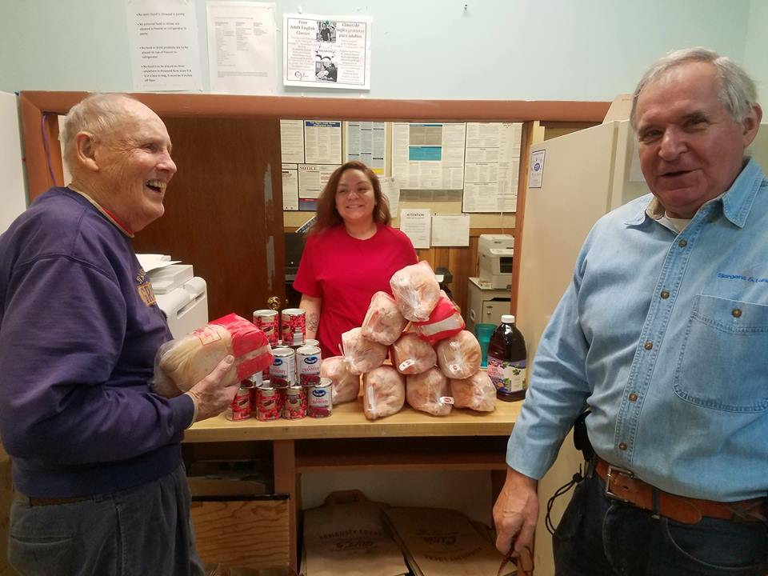
BACK TO BASICS
IMAGES
Add authenticity to your work – use real photos!
TIP: Real images make people 35% more likely to respond to your CTA than stock photos
PRESENTATION BY TIMM KRUEGER | HOUSING ACTION ILLINOIS
Notes:
When it comes to images in general remember: real photos are better than stock! No matter how professional your photos are, we can always tell the difference between stock photography, which feels very impersonal and cold, compared to real photography that you or your staff takes.
However, if you are creating something for print and your image is of lower resolution, you may want to focus less on photography and more on iconography or computer generated designs, which will have a higher DPI and will look better in print.

Slide 20

SPREADING AWARENESS
PRESENTATION BY TIMM KRUEGER | HOUSING ACTION ILLINOIS
Notes:
Now that we’ve broken down a few of the basics, let’s pause and see if there are any questions about images or brand consistency.
Alright, and with that, we’re going to head into spreading awareness, which is the section we’ve all been waiting for. Whenever you create anything marketing related, you need to know what you’re getting yourself into. This is the composing content stage – its where you outline your goals, devise a strategy, and take inventory of everything you have versus everything you need. There are three basic steps to composing content.

Slide 21
SPREADING AWARENESS
COMPOSING CONTENT
STEP ONE
CREATE A CONTENT STRATEGY
How will this be used?
How often will we need it?
PRESENTATION BY TIMM KRUEGER | HOUSING ACTION ILLINOIS
Notes:
Step one is creating a content strategy:
Content strategies are really vital to successful print pieces, because it’s more expensive than just creating digital collateral.

Slide 22


SPREADING AWARENESS
WHAT’S YOUR GOAL?
Promoting events and workshops
Length: short
Ideas: flyer, postcard
Content: info might change
Should look good in B&W
Your goal: catch their attention!
PRESENTATION BY TIMM KRUEGER | HOUSING ACTION ILLINOIS
Notes:
When you’re in the content strategy phase, you’ll start by identifying your goals.
If you remember from the science section, humans have very short attention spans, so it’s important that we grab their attention quickly. That means keeping things short and sweet. So when we’re promoting expos and workshops, or any other event where there is an end date, you want to use a flyer or a postcard – really anything that is inexpensive to produce. It’s going to be tempting to include tons of information – fight that urge! Your audience only wants to know what you’re offering, how it can help them, when it is, and how they can learn more. Send them to your website so they can get as much detail as they want.

Slide 23
SPREADING AWARENESS
WHAT’S YOUR GOAL?
Promoting events and workshops
TIP: Go single-sided if you’re putting them
on bulletin boards
PRESENTATION BY TIMM KRUEGER | HOUSING ACTION ILLINOIS
Notes:
If you’re going to be handing flyers out, or leaving a stack somewhere, your best bet is to create a double-sided flyer. [A] This approach will let you have an eye-catching design on the front that doesn’t suffer from information overload. You may not be able to read everything on this flyer, but you can see how each side serves its own purpose. The front side, which is on the left, has the what, the who, and the where, plus it has a clean, eye-catching design. And on the back, it’s included as much information as is needed, with a call to action for the audience to follow. [A]
But if you’re going to be hanging the flyer on a bullet board, or any other display where it’ll be hanging you’ll want to create a single-sided flyer, or maybe a poster that’s larger. Just make sure that you are careful and really, really prioritize the information you’re going to include on a poster – let the colors, imagery, and text grab their attention and only include the essentials. Single-sided collateral is the most susceptible to information overload.
[Poll] Let’s jump into a quick poll to shake things up: would this flyer look good in black and white?

Slide 24
SPREADING AWARENESS
WHAT’S YOUR GOAL?
Promoting events and workshops
TIP: Go double-sided if you’re handing them
out in-person
PRESENTATION BY TIMM KRUEGER | HOUSING ACTION ILLINOIS
Notes:
If you’re going to be handing flyers out, or leaving a stack somewhere, your best bet is to create a double-sided flyer. [A] This approach will let you have an eye-catching design on the front that doesn’t suffer from information overload. You may not be able to read everything on this flyer, but you can see how each side serves its own purpose. The front side, which is on the left, has the what, the who, and the where, plus it has a clean, eye-catching design. And on the back, it’s included as much information as is needed, with a call to action for the audience to follow. [A]
But if you’re going to be hanging the flyer on a bullet board, or any other display where it’ll be hanging you’ll want to create a single-sided flyer, or maybe a poster that’s larger. Just make sure that you are careful and really, really prioritize the information you’re going to include on a poster – let the colors, imagery, and text grab their attention and only include the essentials. Single-sided collateral is the most susceptible to information overload.
[Poll] Let’s jump into a quick poll to shake things up: would this flyer look good in black and white?

Slide 25

SPREADING AWARENESS
WHAT’S YOUR GOAL?
Promoting events and workshops
TIP: If you can’t print in color, use thick icons, bold fonts, and print on colored paper
PRESENTATION BY TIMM KRUEGER | HOUSING ACTION ILLINOIS
Notes:
If you’re going to be printing off flyers in your office, go with high-resolution, high-contrast photos, and stick with just two colors, so that they look good in black and white. Another workaround is to use icons, or other graphics like you see here, and printing them on colored paper. While printing on colored paper isn’t a new trend, you can tell that these look like they were designed specifically to be on colored paper, rather than just being put on colored paper as an afterthought.

Slide 26
SPREADING AWARENESS
WHAT’S YOUR GOAL?
Information about your organization and services
INFORMATIONAL
WHAT TO INCLUDE
Length: longer
Ideas: brochure, booklet
Content: info won’t change
Invest – use a real printer!
Your goal: be persuasive!
Program description
Who it’s for
How it can help them
Who its helped before
Where they can sign up
PRESENTATION BY TIMM KRUEGER | HOUSING ACTION ILLINOIS
Notes:
Now, if you’re creating something to promote your counseling programs, or to give people more information about your agency, you’ll want something that’s a little longer, like a brochure or a booklet. This information won’t change, so it’s a great investment to have this created professionally, and to have it professionally printed.

Slide 27
SPREADING AWARENESS
COMPOSING CONTENT
STEP TWO
ORGANIZE AND PRIORITIZE
What is essential?
What’s just taking up space?
PRESENTATION BY TIMM KRUEGER | HOUSING ACTION ILLINOIS
Notes:
But remember, the ideal size for a social media graphic is different than an ideal website graphic, and both of those are different than how it’ll look in print. So the next step is to organize and prioritize your content. We are conditioned to expect certain pieces to look certain ways.

Slide 28
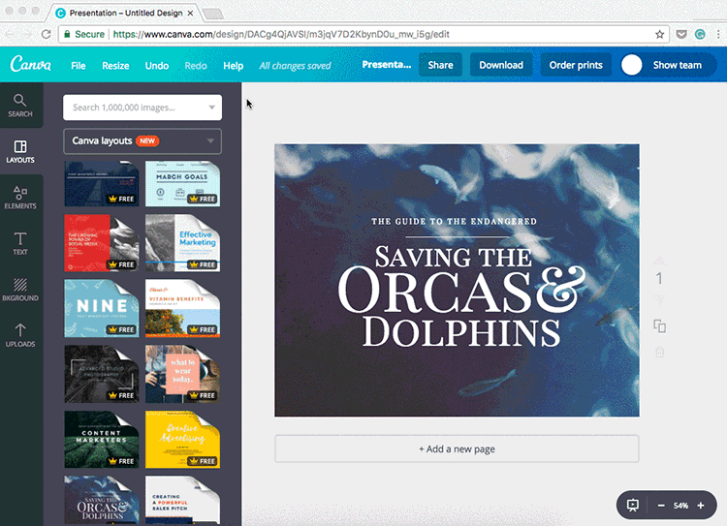
BACK TO BASICS
COMPOSING CONTENT
STEP ONE
CREATE A CONTENT STRATEGY
How will this be used?
How often will we need it?
PRESENTATION BY TIMM KRUEGER | HOUSING ACTION ILLINOIS
Notes:
Don’t include too much information – you can save the flowery language and program descriptions for your website. Make sure that you’re only including exactly what they need to know, so that they can learn about what they want to know by following your call-to-action, whether that’s learning more on your website or attending your program or class.
One way to stretch the life of your marketing dollars is to think of all the ways you can use your print materials before you get to work. Any time you create a flyer or a brochure, be sure create versions of it for your website, social media, and email marketing, if you do that. This allows you to hit your audience in as many places as possible with the same content, which will amplify your reach.
With Canva for Work, which has a free nonprofit version, you can actually use their magic resize tool to automatically take a graphic you created as a flyer and turn it into the optimal size for social media, kind of like what we see on screen right now.

Slide 29
SPREADING AWARENESS
COMPOSING CONTENT
STEP THREE
MAKE YOUR PURPOSE CLEAR
Don’t bury the lead
Tell them what they need to know
PRESENTATION BY TIMM KRUEGER | HOUSING ACTION ILLINOIS
Notes:
And finally, make sure that your purpose is as clear as possible, which should be an easy step after you’ve planned out your content strategy and have organized and prioritized your content [A].
If you look at this flyer again, you’ll notice that the header says free housing counseling, but it’s followed by the dates and locations. But those are the reasons people attend – those are where they can attend. They buried the most important part of their information at the bottom, where it tells you what you can learn about. While we may believe that people will take the time to find information that’s relevant to them, remember that flyers are just like pop-up ads – if we do pay attention to it, it won’t be for long, so we have to make sure the most important information is highly visible and not hidden.

Slide 30

SPREADING AWARENESS
DIRECT MAIL CAMPAIGNS
Stand out in the mailbox
Beware – some reports suggest that just 3.4% of recipients respond to direct mail
Make it interactive
Be bold – grab their attention
Clear call-to-action
PRESENTATION BY TIMM KRUEGER | HOUSING ACTION ILLINOIS

Slide 31

SPREADING AWARENESS
CONTENT STRATEGY
PRESENTATION BY TIMM KRUEGER | HOUSING ACTION ILLINOIS
Notes:
Fundraising campaigns can be really complemented or enhanced with high quality print materials, but there are so many different audiences that you can speak to, and such a variety of stages in a fundraising content strategy that it can be a little overwhelming.

Slide 32
SPREADING AWARENESS
THREE AUDIENCES
PROSPECTIVE
FRIENDS YOU HAVEN’T MET YET
Require more initial information
Use your elevator pitch
EXISTING
AFTER THE ASK
Thank them
Update them, then ask again
LAPSED
LONG LOST RELATIVES
Remind them of who you are
Remind them how they helped the community
PRESENTATION BY TIMM KRUEGER | HOUSING ACTION ILLINOIS
Notes:
I broke down the various audiences you can speak to in a fundraising cycle, and while we don’t have time to go through all of them, you can see that each stage, whether they’re prospective funders or existing, they all require different information, and that has to be taken into account as you plan your content strategy.

Slide 33
SPREADING AWARENESS
WHAT’S YOUR GOAL?
INDIVIDUAL GIVING
INSTITUTIONAL FUNDERS
Hi-res images
Tell a story
Demonstrate your impact
Tell them how they can help – don’t assume they know
Shorter
Think: postcard or up to two pages
Bonus: remittance envelopes
Longer –
Up to eight pages
Think: annual report,
bi-fold booklet
PRESENTATION BY TIMM KRUEGER | HOUSING ACTION ILLINOIS
Notes:
It gets even more complicated when you look at the difference between individual giving and institutional funders, such as banks or foundations. Your calls to action will be different for each, and the level of attention they give you will be drastically different, as well.
Individual giving campaigns will be shorter, whereas institutional funders will be longer. But each one will require high resolution images that help tell your story. You’re trying to persuade them to care enough to give you money, so make sure you’re not just telling them what you want to do with the money. Instead, show them how you have already been successful in previous programs or endeavors and then tell them how you can be even more successful with their help.

Slide 34
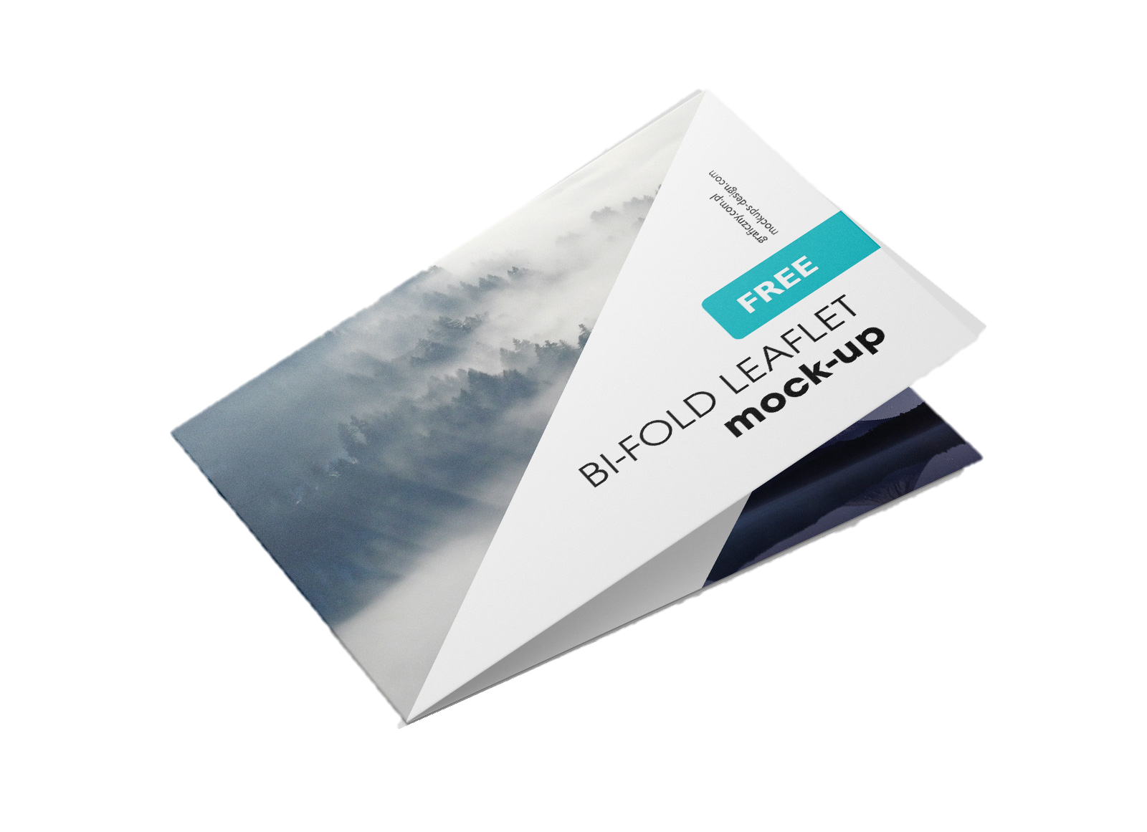
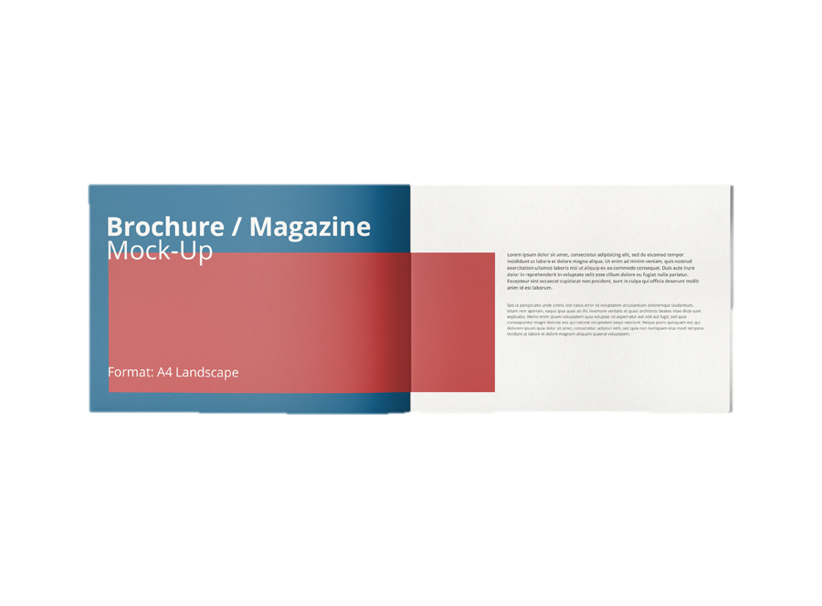
SPREADING AWARENESS
NOW TRENDING
PRESENTATION BY TIMM KRUEGER | HOUSING ACTION ILLINOIS
Notes:
Sometimes we can stand out to funders by giving them a format they may not expect, like this bi-fold booklet, which is growing in popularity. This is a great substitute for a brochure or a pamphlet, because it has the same surface area, but it’s in a unique format that allows for more creativity.

Slide 35
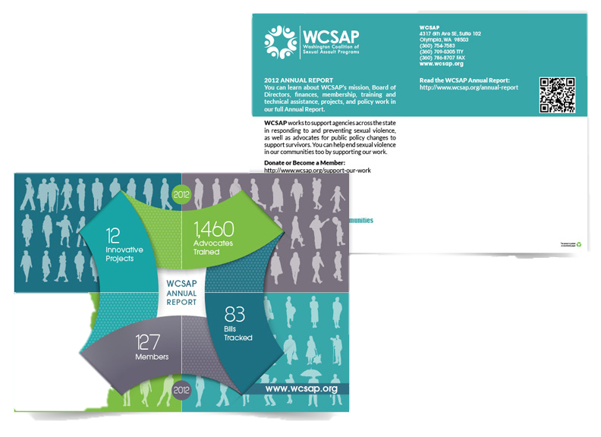
SPREADING AWARENESS
NOW TRENDING
PRESENTATION BY TIMM KRUEGER | HOUSING ACTION ILLINOIS
Notes:
And like I’ve been saying all throughout the training, it can be really expensive to print things, so another way to avoid printing your big, thoroughly written annual report, is by creating an announcement postcard that has similar images from the report, and then directing people to visit your website to see the full report.
My recommendation for this approach is to include the most important thing you want people to know from your report and put it on the front, that way even if they don’t visit your site, they still are learning about what your impact is. I would avoid a post card that simply says “Our annual report is now available!” because it is a missed opportunity, and an expensive one, at that!

Slide 36
BACK TO BASICS
REMEMBER THIS?
The anatomy of good print collateral
  Eye-catching
  Good use of color
  Balanced
  Proof read!
PRESENTATION BY TIMM KRUEGER | HOUSING ACTION ILLINOIS
Notes:
After you’ve composed your content, there’s one more step you need to take in order to make sure you’re creating something good: you have to proofread!

Slide 37
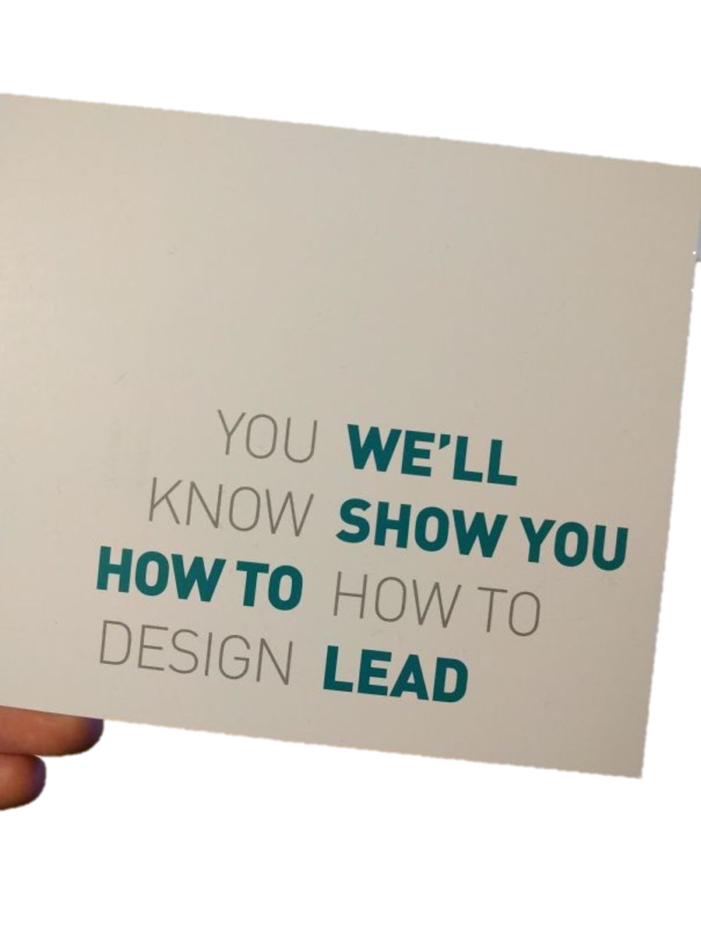

BACK TO BASICS
PROOFREADING
The devil is in the details
TIP: Measure twice, cut once – always proofread before you send your piece to print
PRESENTATION BY TIMM KRUEGER | HOUSING ACTION ILLINOIS
Notes:
Proofreading isn’t just about making sure that you don’t have any typos in your content – it’s also about making sure that it makes sense! That means you should be reading it out loud, having someone who is unfamiliar with the project take a look – whatever it takes to make sure your audience will understand it, too.
I have these two pictures up to show you the importance of visual hierarchy – remember, we read right-to-left, and these examples are proof reading fails, in my opinion. The first one says ”You we’ll know show you how to how to design lead” – what does that even mean? They used a really cool and clever design trick, but they didn’t really do themselves any favors by how they laid out the content here.
The picture on the right has a similar issue – my reason for showing you the pringles can, specifically, is because I want you to see that even big brands can make mistakes!

Slide 38

MEASURING SUCCESS
PRESENTATION BY TIMM KRUEGER | HOUSING ACTION ILLINOIS
Notes:
Before we head into our last section, does anyone have any questions on spreading awareness?
Alright, our last section is on Measuring Success. In my previous webinars, I’ve talked a lot about the importance of reports. The reason why these are so critical is because good marketing is all about trial and error. You can’t out all your eggs in one basket – you have to be able to see what’s working, what isn’t, and then allocate your resources accordingly. Measuring success is really, really critical for us as housing counseling professionals because, as you know, we’re expected to do more with less each year. That means that we need to pay special attention to our marketing dollars, how much is being spent, what it’s being spent on, and if we’re getting the results we need.

Slide 39
MEASURING SUCCESS
TRACKING THINGS YOU CAN’T CLICK
Quantity
Demographics
When did you send it?
PRESENTATION BY TIMM KRUEGER | HOUSING ACTION ILLINOIS

Slide 40
MEASURING SUCCESS
TRACKING THINGS YOU CAN’T CLICK
QR CODES
PRESENTATION BY TIMM KRUEGER | HOUSING ACTION ILLINOIS

Slide 41

MEASURING SUCCESS
TRACKING THINGS YOU CAN’T CLICK
CUSTOM PHONE NUMBER
PRESENTATION BY TIMM KRUEGER | HOUSING ACTION ILLINOIS

Slide 42
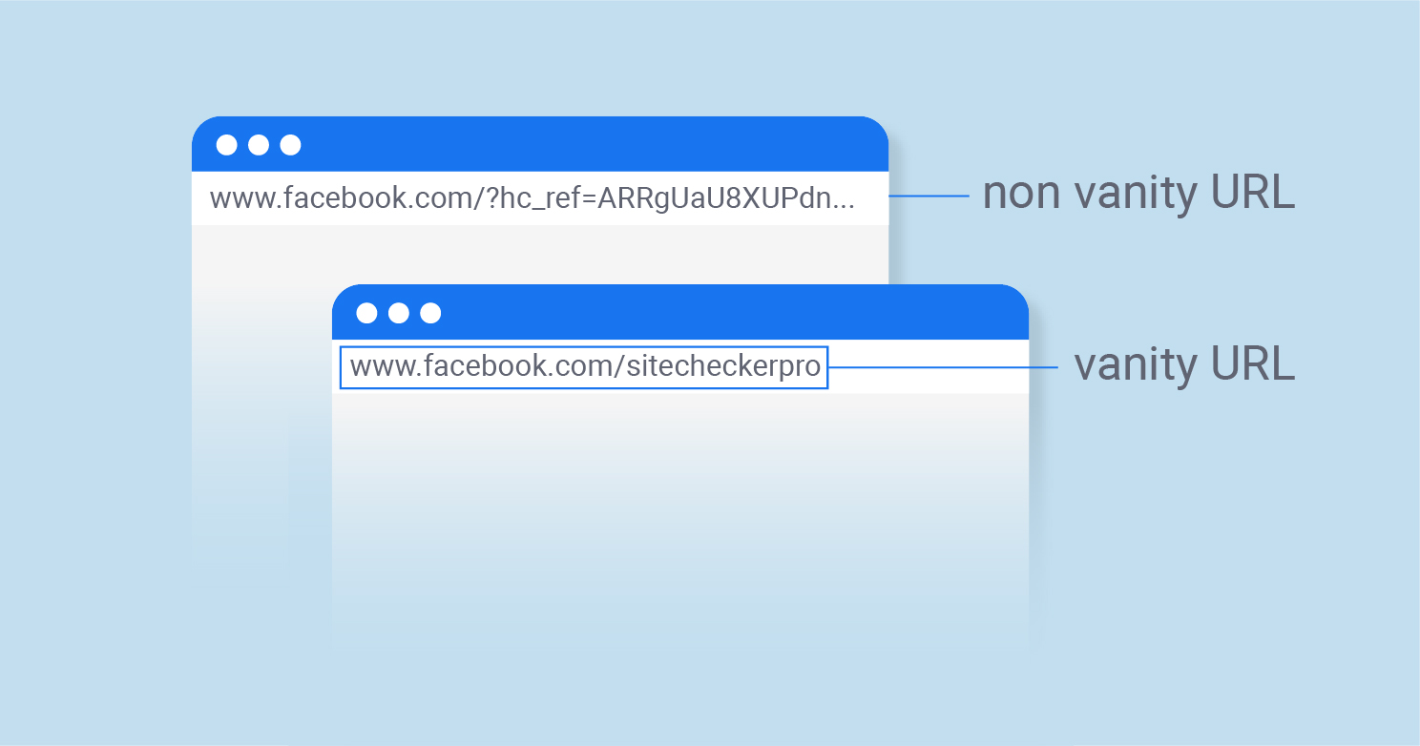
MEASURING SUCCESS
TRACKING THINGS YOU CAN’T CLICK
VANITY URL
PRESENTATION BY TIMM KRUEGER | HOUSING ACTION ILLINOIS

Slide 43
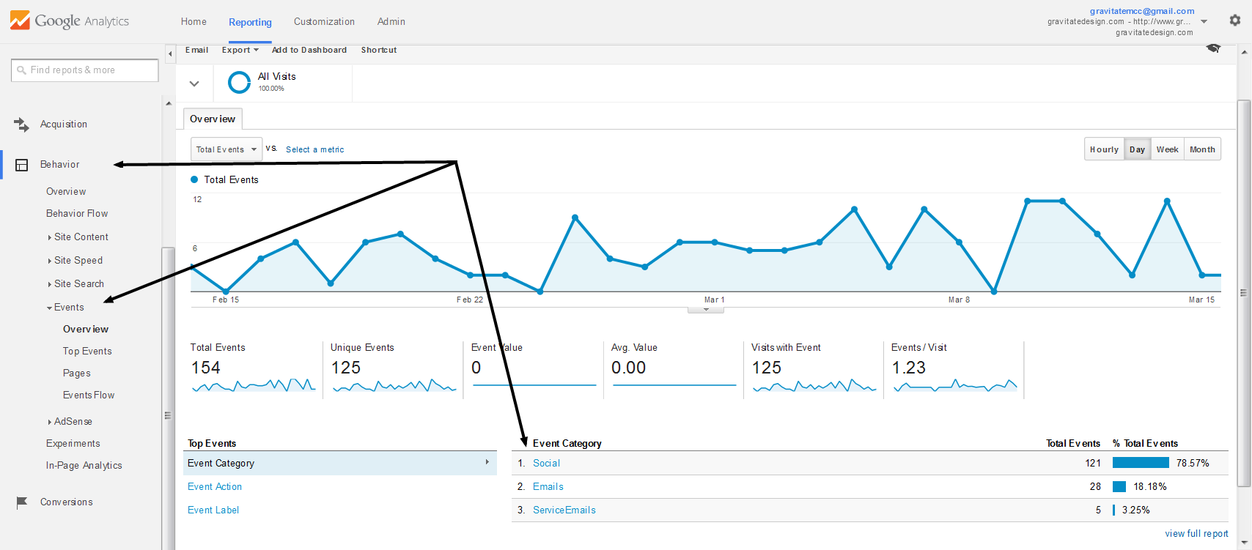
MEASURING SUCCESS
TRACKING THINGS YOU CAN’T CLICK
GOOGLE ANALYTICS EVENTS
PRESENTATION BY TIMM KRUEGER | HOUSING ACTION ILLINOIS

Slide 44
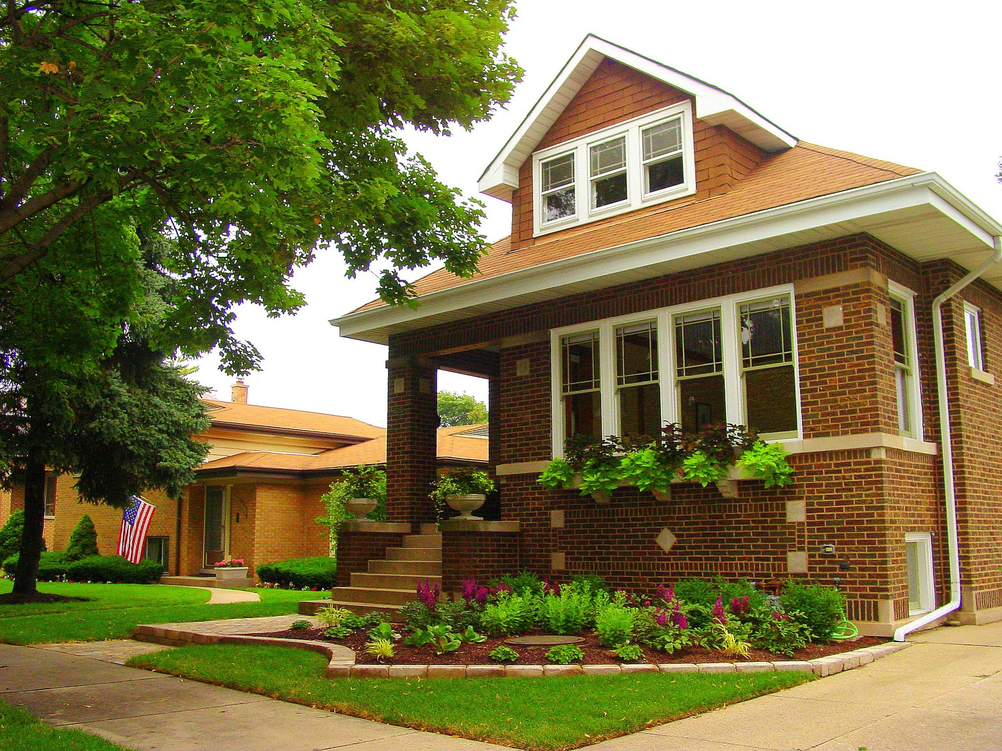
THANK YOU
Timm@HousingActionIL.org
PRESENTATION BY TIMM KRUEGER | HOUSING ACTION ILLINOIS

