Slide 1
Storytelling for Housing Counselors
HOUSING ACTION ILLINOIS

Slide 2
MEET THE PRESENTERS
MARISSA DIEKHOFF
HOUSING ACTION ILLINOIS
COMMUNICATIONS & RESOURCE DEVELOPMENT VISTA
marissa@housingactionil.org
KRISTIN GINGER
HOUSING ACTION ILLINOIS
COMMUNICATIONS MANAGER
kristin@housingactionil.org
HOUSING ACTION ILLINOIS
Notes:
MD & KG

Slide 3
UPCOMING WEBINARS
AUGUST 21 PRINT MATERIALS
HOUSING ACTION ILLINOIS
Notes:
KG

Slide 4
REGISTRATION IS NOW OPEN!
$50 off the full-price conference registration This won’t last long – register by August 17 to save!
* TIP: You can use FPP-G training funds for registration
HOUSING ACTION ILLINOIS
Notes:
KG

Slide 5
TODAY’S AGENDA
?
WHY, WHAT, HOW
GATHERING STORIES
SHAPING STORIES
STORIES IN ACTION
HOUSING ACTION ILLINOIS
Notes:
KG

Slide 6
WHY, WHAT, HOW
HOUSING ACTION ILLINOIS
Notes:
KG

Slide 7
?
WHY, WHAT, HOW
WHY TELL STORIES?
They help people understand what you do and why
They compel people to act
People remember things better
People empathize when they hear stories
HOUSING ACTION ILLINOIS
Notes:
KG
How does storytelling enhance your communications? It often feels like we have to come up with a new spin to sell things that we’ve been doing that we know work. Storytelling is a way to share successes, lessons learned, etc. in a fresh way to help people understand how a program has been working recently or what needs to happen next with it and get people to connect in the moment.
Facts and figures are important, and are often a part of good storytelling, but aren’t always enough on their own. They’re easy to forget, and can be meaningless without context.
Take time to ask about last compelling story someone heard (doesn’t have to be work related—pull inspiration from outside. Your kid, a movie, etc.)

Slide 8
?
WHY, WHAT, HOW
WHAT IS A STORY?
Not always a full-fledged narrative
Elements of storytelling
Quotes
Visuals
Details
HOUSING ACTION ILLINOIS
Notes:
KG

Slide 9
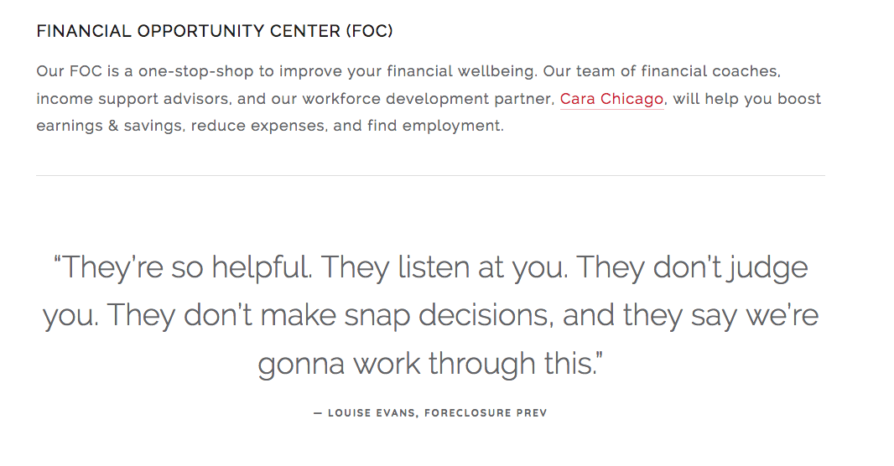
?
WHY, WHAT, HOW
STORYTELLING ELEMENTS
QUOTES
HOUSING ACTION ILLINOIS
Notes:
KG
First person voice of a client is great, but even a quote from a housing counselor can personalize information. Edit down what someone says to the essence.

Slide 10
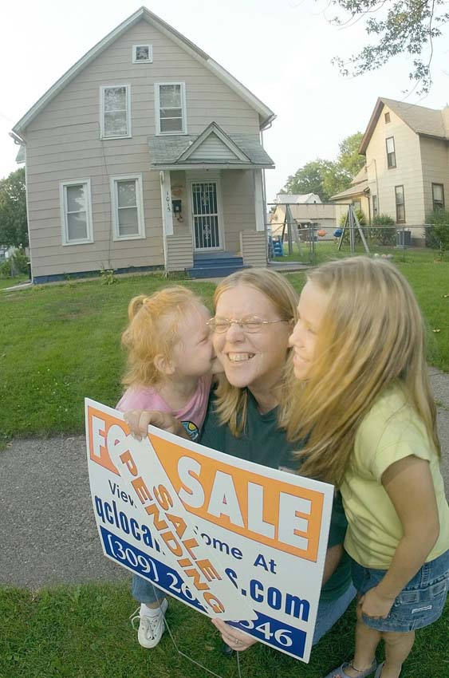
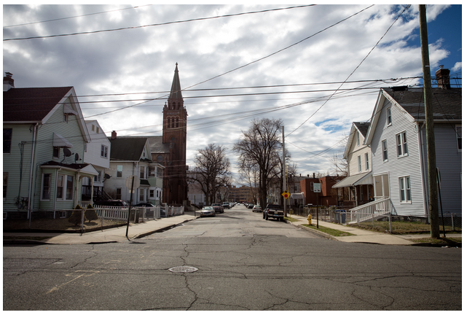
?
WHY, WHAT, HOW
STORYTELLING ELEMENTS
VISUALS: PHOTOS
Left: Shared with Housing Action Illinois by Project Now
Middle: ‘Protecting Families: A Photo Story About Supportive Housing,’ How Housing Matters
Right: Stock photo
HOUSING ACTION ILLINOIS
Notes:
KG
Source stock photo—pixabay, pexel
Of people or things. People tend to be more engaging, even if you’re just showing part of them. Sometimes a client might be more comfortable with having a photo of their hands holding keys or opening a door, or of them filling out a lease or going through their wallet. It’s also great to show homes, and that might mean a community or street, or it could be a photo of their house, a front door, event just a window or a door knob. If you’re going to rely on stock photos, try to get ones that seem more believable.

Slide 11
?
WHY, WHAT, HOW
STORYTELLING ELEMENTS
VISUALS: GRAPHICS
HOUSING ACTION ILLINOIS
Notes:
KG
Sometimes you might just have rolled up numbers, and to help make a story out of those you can add representational graphics.

Slide 12
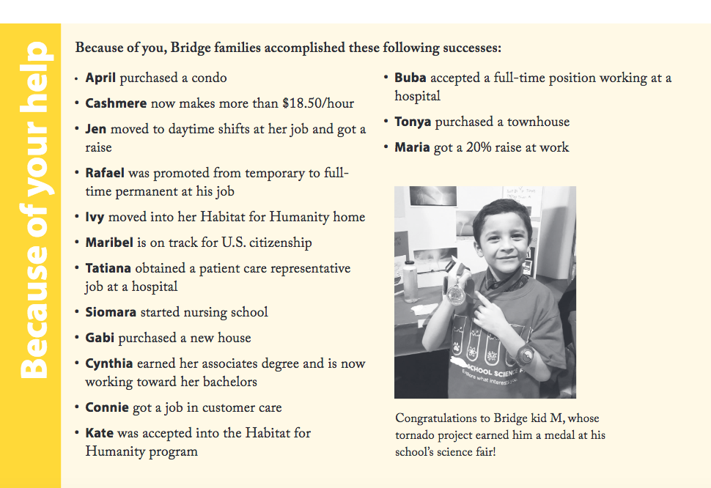
?
WHY, WHAT, HOW
STORYTELLING ELEMENTS
DETAILS: NAMES AND NUMBERS
HOUSING ACTION ILLINOIS
Notes:
KG

Slide 13
?
WHY, WHAT, HOW
HOW ARE YOU TELLING STORIES?
In conversation
Online
In print
Grants & program proposals
Events
Fundraising
HOUSING ACTION ILLINOIS
Notes:
KG

Slide 14
?
WHY, WHAT, HOW
WHO IS TELLING YOUR STORIES?
WHO ARE THEY TELLING THEM TO?
Staff
Clients
Board
Funders
Media
Community members
Clients
Community
Funders
Landlords
Peer organizations
Friends and family
HOUSING ACTION ILLINOIS
Notes:
KG
Some are more internal than others; some are more controllable than others.
Think about how you’re equipping these different groups to tell stories.
What resources would be helpful that you might be able to create?

Slide 15
?
WHY, WHAT, HOW
WHY TELL HOUSING COUNSELING STORIES?
New clients
More funding
Community support
Gain volunteers
Raise awareness
HOUSING ACTION ILLINOIS
Notes:
KG
People often don’t know what housing counseling is
They help with fundraising
They can bring in new clients
being everyone from potential clients and funders to your community and

Slide 16
GATHERING STORIES
HOUSING ACTION ILLINOIS
Notes:
KG

Slide 17
GATHERING STORIES
EVERYDAY STORY COLLECTION
Collect the stories you have, as they happen
Create simple processes
Equip all staff & create incentives
Lead by example – share stories internally!
Opportunities:
Client files
Intake forms
Staff meetings
Trainings & events
HOUSING ACTION ILLINOIS
Notes:
MD
Build a storytelling culture at your organization
Think about your day-to-day interactions as opportunities for story collection
Often easiest to gather stories as they’re being told to you
Be prepared!
Keep release forms with you
Know how to use the recording function on your phone
Have a list of questions or a story collection form on hand
Think in quotes and write it down!
Create a collection process that is simple and designed with user intent
People are busy…think about creating forms and designating a set process for getting the details you want
Take advantages of these opportunities to the right, whether written or verbal
Add a story sheet to every client file
Add sections for quotes/stories on intake & feedback forms
Share stories at staff meetings
Anecdotal collection at trainings
Ask class to share what they got out of a training & write down answers, then follow-up with people who gave great responses
Start a training with a survey (How many of you dreamed of buying a home when you were little?– you can tell a lot from a show of hands
Make sure all staff know what you’re looking for in a story (we’ll go into what makes a good story in a moment) & what pieces you might want to collect (those storytelling elements mentioned earlier—quotes, visuals, details)
Train staff on interviewing techniques
Explain how to use release forms
Don’t forget to share stories internally-- you never know what another staff could learn from your experience with a client or when they could fill in other details (maybe a client went to their training)
Focus on collecting the stories that you already have in a way you can use them/gathering them as they happen or you hear them.
This might just be a lens shift as you go through your day—and being prepared with the materials you need, such as a camera or story release waiver.
Maybe you also have enough time to actively go out and gather stories.
There are a lot of kinds of stories out there—in addition to one person’s experiences and how they connected with you (client story), you can tell the story of:
How your organization was founded (and maybe the founder’s story)
A story of change (either your theory of change or a transition that happened)
A vision story (what you want your community to look like or a theoretical person’s story in a more ideal world)
A funder story (be wary of making your donor the hero, which was a popular trend in fundraising recently—still is)
Who needs to know? Case manager, comms staff
What do you need to know? Get familiar with their relationship with your organization, talk to whoever has worked with them most recently, learn about any program they went through so if they say “SOAR” you know they’re not talk about flying, how to have supportive conversations with people who have experienced trauma, has your organization told their story before and how, have other organizations, where and how you might be sharing the story (even if not set in stone)
What do you need to bring? Camera, recorder, waiver, your business card, a person they’re more comfortable with, questions, money to buy them coffee or lunch, any relevant templates/info gathering documents
Scheduling—remember this person is taking their time to share personal experiences and you might have to meet with them in the evening or during the weekend. Offer to come to them, offer up those time windows.

Slide 18
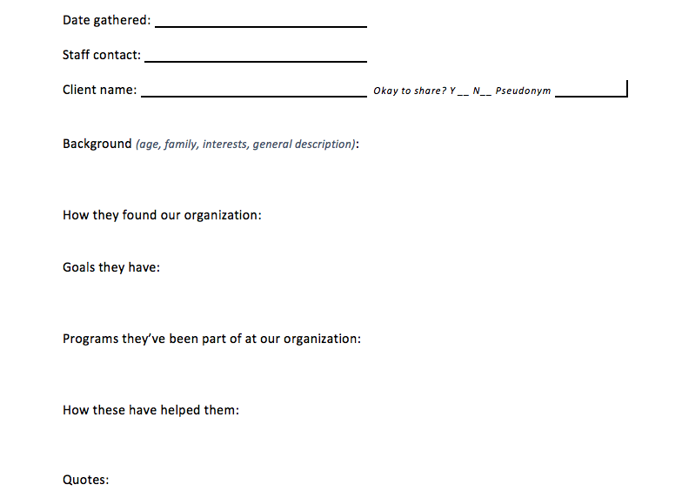
GATHERING STORIES
STORY COLLECTION FORM
HOUSING ACTION ILLINOIS
Notes:
MD

Slide 19
GATHERING STORIES
IN-DEPTH STORY COLLECTION
Think back:
Follow-up stories
Reoccurring clients
Former staff/board
Think ahead:
Trainings
Meetings
Annual Report
Fundraising Campaigns
Grant Reports
HOUSING ACTION ILLINOIS
Notes:
MD
Think back to stories you could have collected or could expand on
What sticks out from your time here?
Someone who may have a success story now
Client who came to multiple trainings
Think ahead to identify potential opportunities for both collection and sharing
Plan in advance for upcoming meetings and trainings
Incorporate storytelling into communications, development, & programmatic activities:
Annual report
Fundraising campaigns
Grant report

Slide 20
GATHERING STORIES
BEST PRACTICES
Collection
Get context—if you don’t know the client, talk to someone who does
Record the conversation & take photos
Schedule time to meet or call
Ease into your questions
Ask for details
Be patient
HOUSING ACTION ILLINOIS
Notes:
MD
Get context - Who needs to know? & What do you need to know? Get familiar with their relationship with your organization, talk to whoever has worked with them most recently, learn about any program they went through so if they say “SOAR” you know they’re not talk about flying, how to have supportive conversations with people who have experienced trauma, has your organization told their story before and how, have other organizations, where and how you might be sharing the story (even if not set in stone)
Record the conversation – bring something to take notes on and test your recorder beforehand; ALWAYS ask to record and make sure they know what your process is for using/storing the audio
Bring a camera or take photos on your phone, or follow-up and ask for a photo they’re comfortable sharing
Scheduling—remember this person is taking their time to share personal experiences and you might have to meet with them in the evening or during the weekend. Offer to come to them, offer up those time windows. Set aside time. Their story is important and shouldn’t be rushed.
Don’t start with the heavy-hitters… Ask where they’re coming from, how their day was, etc. & build rapport while learning more about them
Remember to ask about the person, not just about their issue or a series of events
This is where you find out those personal details that enhance a story and help people connect
Be patient – let there be silence and give space for people to talk around and through answers
Listen carefully and actively…if something is unclear, try to wait for them to finish and follow-up with your question (sometimes tangents bring you back to a point unexpectedly)

Slide 21
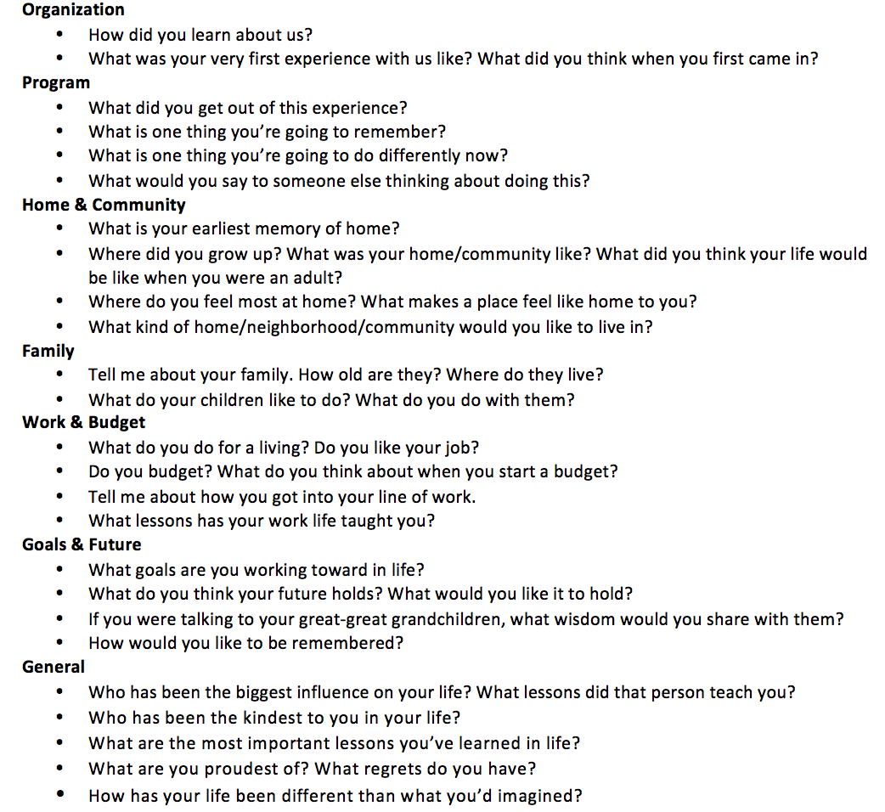
GATHERING STORIES
CLIENT INTERVIEW QUESTIONS
HOUSING ACTION ILLINOIS
Notes:
MD
KG to create

Slide 22
GATHERING STORIES
BEST PRACTICES
Photography
Any visual is better than none
Get close to your subject
Follow the light
People, places, & things
HOUSING ACTION ILLINOIS
Notes:
MD
We’re visual beings…Photographs keep your audience’s attention for longer, help them remember a story better, often encourage them to connect to a story, provide details that words can’t (what does their home look/feel like?), and help enhance your credibility
People are more likely to engage and linger on posts w/ images
People remember things better when text and images are consumed together
People trust facts more when paired w/ images
If not a photo you take or a stock photo, consider adding graphics, colors, or visual design
Make your subject fill the frame of a photo… Eliminate things like crowds or cluttered backgrounds that might distract from your main subject (whether a person or thing) by moving closer or zooming in
This could mean crouching down to get to someone’s eye level or only focusing on a few people in a room
Eye contact is emotionally powerful
Light can make or break a photograph - move yourself and your subject around to find somewhere with enough light (but not too much)
If there’s not enough light available, try moving closer to a light source or adding more light by bringing in another lamp or using the flash on your camera/phone
While people are the most compelling subjects, don’t only think of a good photograph as one of a person
What could a photograph of someone’s street tell you? What about their bedroom? Their keychain or something they’ve kept with them throughout periods of homelessness?
If someone does not want to be photographed, LISTEN & don’t force them. When photographs can be easily accessed online, someone’s privacy should always come first. Think about photographing non-identifying parts of them (their hands holding or signing something, their feet walking into a doorway, etc.) or finding objects that could represent their story.

Slide 23
GATHERING STORIES
BEST PRACTICES
Consent
Always get consent when someone can be identified
Release forms & opting-out
Informed consent: How will it be used? Where? When? Why?
HOUSING ACTION ILLINOIS
Notes:
MD
Ideal to have waivers around with you all the time, but think about if there’s implied pressure because the person is there for other services
Pseudonyms and compilation stories
Informed consent
Always get consent before sharing someone’s story
Explicit vs. implicit consent
Allow people to opt-out
Release forms and reasonable understanding
How? Where? When? Why?

Slide 24
GATHERING STORIES
BEST PRACTICES
Post-Collection
Transcription
If you can’t transcribe everything, at least write out a few strong quotes
Story bank
Gather stories in one place that is shared by multiple staff
Active use
Make sure staff know what stories you’re collecting and sharing
HOUSING ACTION ILLINOIS
Notes:
MD
Transcription template/tips—flagging sections, selective transcription, software to slow down audio to type at pace of speech
Story banks—keeping these up to date, who has access is important
Active use – finding new ways to share stories at your organization (ex. creating specific platform for storytelling) and incorporating them into your current communications/fundraising/programmatic strategies and materials

Slide 25
SHAPING STORIES
HOUSING ACTION ILLINOIS
Notes:
KG

Slide 26
SHAPING STORIES
EFFECTIVE STORYTELLING
Qualities that make an idea “stick”:
Simple
Know the core of your message; be focused
Unexpected
Includes a break from the ordinary
Concrete
Includes sensory information
Credible
Personal experience, statistics
Emotions
Give people a reason to care; build associations
Stories
Create a narrative framework
HOUSING ACTION ILLINOIS
Notes:
KG
Chip & Dan Health published this in 2007. Chip is a professor at Stanford's business school, Dan a teacher and textbook publisher, and they drawing extensively on psychosocial studies on memory, emotion and motivation as they explore what makes some ideas stick—what makes them memorable-–why others are easily forgotten. Why is it that a false story, an urban legend about organ harvesting, goes viral, while a really important story that a journalist wants to get out into the world to make a change, is quickly forgotten?

Slide 27
SHAPING STORIES
WHAT MAKES A GOOD STORY?
Protagonist
Conflict
Journey
Framing/call to action
HOUSING ACTION ILLINOIS
Notes:
KG

Slide 28
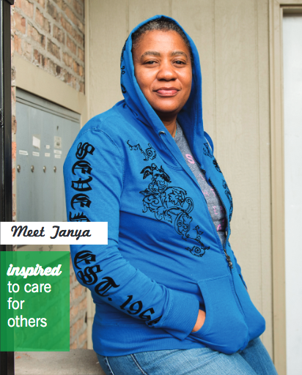
SHAPING STORIES
WHAT MAKES A GOOD STORY?
Protagonist
Someone to root for
HOUSING ACTION ILLINOIS
Notes:
KG

Slide 29
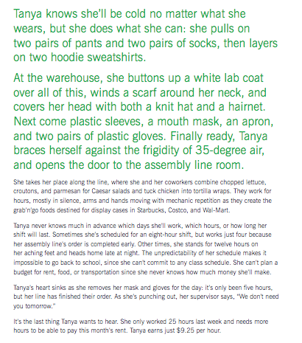
SHAPING STORIES
WHAT MAKES A GOOD STORY?
Conflict
What’s in the way?
Establish the everyday
Inciting incident
Build tension
HOUSING ACTION ILLINOIS
Notes:
KG

Slide 30
SHAPING STORIES
WHAT MAKES A GOOD STORY?
Conflict
Something happens that stands in the way of a goal
As she’s punching out, her supervisor says, “We don’t need you tomorrow.”
It’s the last thing Tanya wants to hear. She only worked 25 hours last week and needs more hours to be able to pay this month’s rent. Tanya earns just $9.25 per hour.
HOUSING ACTION ILLINOIS
Notes:
KG

Slide 31
SHAPING STORIES
WHAT MAKES A GOOD STORY?
More Conflict
Things go from bad to worse
Because Tanya’s mother died when she was just a baby, her father raised Tanya and her four older siblings on his own. Now, the roles have been reversed: Tanya does everything she can to help care for him. He’s 84 and is battling prostate cancer.
Since she doesn’t earn paid sick days—like 80 percent of low-wage workers—she has had to forgo work to take her dad to his doctor’s appointments, something she can ill afford to do. But Tanya’s father was there when she needed him, and she won’t let him down now.
HOUSING ACTION ILLINOIS
Notes:
KG

Slide 32
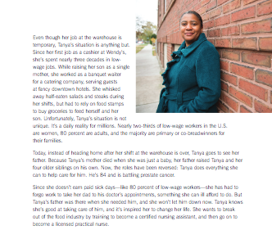
SHAPING STORIES
WHAT MAKES A GOOD STORY?
Journey
What happened?
How did it happen?
HOUSING ACTION ILLINOIS
Notes:
KG

Slide 33
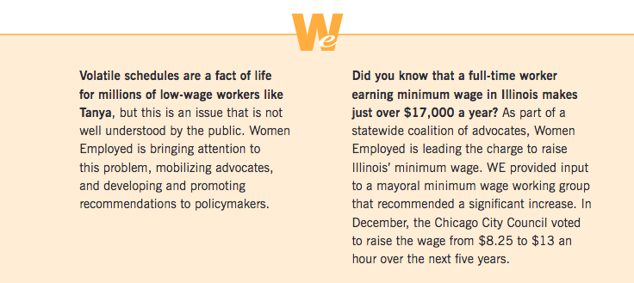
SHAPING STORIES
WHAT MAKES A GOOD STORY?
Journey
What did your organization actually do to help?
BE SPECIFIC
Implied journey
Tanya knows she’s good at taking care of him, and it’s inspired her to change her life. She wants to break out of the food industry by training to become a certified nursing assistant, and then go on to become a licensed practical nurse.
HOUSING ACTION ILLINOIS
Notes:
KG

Slide 34
SHAPING STORIES
WHAT MAKES A GOOD STORY?
Framing
What is the takeaway?
What is your overall goal in telling the story?
Success or lesson learned
Call to action
Clear, specific, ideally immediate thing your audience should do
HOUSING ACTION ILLINOIS
Notes:
KG

Slide 35
STORIES IN ACTION
HOUSING ACTION ILLINOIS
Notes:
TK

Slide 36
WHO REMEMBERS THESE?
HOUSING ACTION ILLINOIS
Notes:
TK

Slide 37
STORIES IN ACTION
TURN THIS…
[CLIENT NAME] wanted [GOAL] but [OBSTACLE] was in their way. When [ANOTHER OBSTACLE], they thought they would never achieve [GOAL].
HOUSING ACTION ILLINOIS
Notes:
KG

Slide 38
STORIES IN ACTION
TURN THIS…INTO THIS!
Mary wanted to buy a home, but she had no idea where to begin – the homebuying process was confusing. When she saw the homes that were available in her price range – due to her poor credit – she thought she’d never own a home.
After going through our personalized counseling, Mary was able to create a budget, develop a realistic plan to build her savings, and improve her credit score. Now, Mary has closed on her dream home.
There are hundreds of people just like Mary in our community – make a gift today to help us provide counseling services and increase stable homeownership in our community.
HOUSING ACTION ILLINOIS
Notes:
KG

Slide 39
STORIES IN ACTION
USING THIS…
Quotes from homebuyer workshop feedback survey
Photos she emailed when asked
Basic information from intake form
Counselor anecdotes from talking to her
HOUSING ACTION ILLINOIS
Notes:
KG

Slide 40
STORIES IN ACTION
STORY MAD LIBS
SOCIAL MEDIA LENGTH
MARKETING EMAILS
WEBSITE AND BLOG
ANNUAL REPORT
NEWSLETTER
…for a variety of audiences!
HOUSING ACTION ILLINOIS
Notes:
KG

Slide 41
RESOURCES
housingactionil.org/storytelling
HOUSING ACTION ILLINOIS
Notes:
KG

Slide 42
RESOURCES (FPP-G)
Best practices for storytelling
Story/photo waiver
Client story form
Questions for housing counseling client
Choose your own adventure?
HOUSING ACTION ILLINOIS
Notes:
KG
Best practices for storytelling (MD)
Story/photo waiver (exists…MD to take look and make general?)
Client story form (KG)
Questions for housing counseling clients (KG)

Slide 43
THANK YOU
QUESTIONS?
KRISTIN GINGER
kristin@housingactionil.org
MARISSA DIEKHOFF
marissa@housingactionil.org
HOUSING ACTION ILLINOIS

