Slide 1
Social Media
For busy housing counselors

Slide 2
Agenda
Part I – Why this matters
Part II – Best Practices
Part III – Advertising 101
Part IV – Taking Action

Slide 3
Timm Krueger
University of Iowa alumnus
Former gymnast, including two years at Iowa
Pursuing my master’s in Strategic Communication
Housing Action Illinois
Sept. 2017 - Present
SmithBucklin
Dec. 2015 – May 2017
Peoria Housing Authority
Aug. 2014 – Dec. 2015
S&S Property Management
Mar. 2013 – Mar. 2014
Notes:
Add icons for messaging 101, internal communications, communications and putting it all together; icons will change color when we’re talking about that topic

Slide 4
Five years experience in marketing and communications
Public image campaign for the Peoria Housing Authority
Executed marketing plans for 13 in-person events, ranging in size from 250 to 8,000+ attendees
Email marketing, social media management, content creation
Housing Action Illinois
Sept. 2017 - Present
SmithBucklin
Dec. 2015 – May 2017
Peoria Housing Authority
Aug. 2014 – Dec. 2015
S&S Property Management
Mar. 2013 – Mar. 2014
Notes:
Add icons for messaging 101, internal communications, communications and putting it all together; icons will change color when we’re talking about that topic

Slide 5
About Communications 101
New initiative to help build capacity with Housing Action Illinois member organizations that have received the FPP-G grant
Webinars hosted every six weeks on topics relevant to housing counselors and their agencies
Coaching opportunities will accompany each webinar

Slide 6
Upcoming Webinars
June – Email
July – Storytelling
Aug. – Print Materials
*Webinar dates and topics subject to change.

Slide 7
Upcoming Webinars

Slide 8
Take 10 seconds and think of a professional athlete

Slide 9
Take 10 seconds and think of a professional athlete
What do social media and golf have in common?

Slide 10
Social media matters – a lot
In 2005, just 5% of adults used social media
Today, 69% of U.S. adults use at least one social media site
!!!: 74% of Facebook users are on it daily
Part One
Why this matters
Part Two
Best Practices
Part Three
Advertising 101
Part Four
Taking Action

Slide 11
Change how you think about social
Social media more than a leisure activity
Social media is a tool for you to connect with your audience in authentic ways, in real time
Part One
Why this matters
Part Two
Best Practices
Part Three
Advertising 101
Part Four
Taking Action

Slide 12
Why should HC’s care about social?
Part One
Why this matters
Part Two
Best Practices
Part Three
Advertising 101
Part Four
Taking Action
Source: Pew Research Center, 2018

Slide 13
Why should HC’s care about social?
According to NeighborWorks:
Pre-purchase counseling clients are more likely to be African American, Hispanic or Latino/a, low-income, or female
There’s a good chance your target audience uses social media
Part One
Why this matters
Part Two
Best Practices
Part Three
Advertising 101
Part Four
Taking Action

Slide 14
Key players
Part One
Why this matters
Part Two
Best Practices
Part Three
Advertising 101
Part Four
Taking Action

Slide 15
Here’s how you use social media
Part One
Why this matters
Part Two
Best Practices
Part Three
Advertising 101
Part Four
Taking Action

Slide 16
Questions?

Slide 17
Part II – Best Practices

Slide 18
In this section…
We’re going to go over
Social media do’s and don’ts
What types of content you should post, and how often you should post it
Part One
Why this matters
Part Two
Best Practices
Part Three
Advertising 101
Part Four
Taking Action

Slide 19
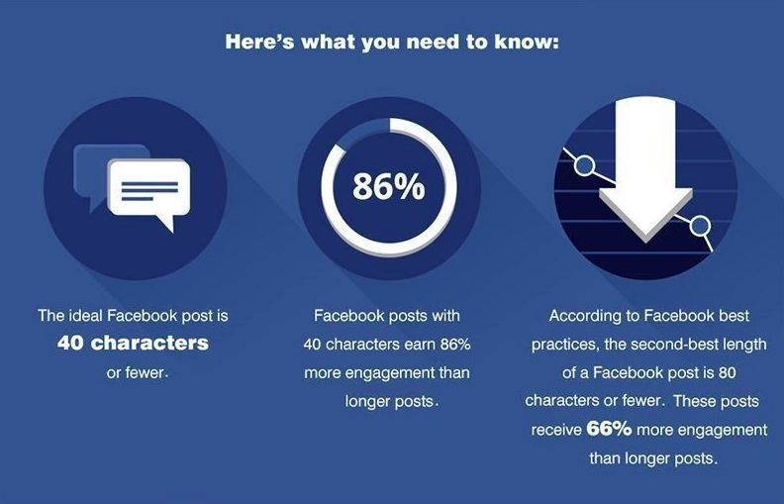
Social media do’s and don’ts
DO
Keep it short and sweet!
DON’T
Write a novel

Slide 20
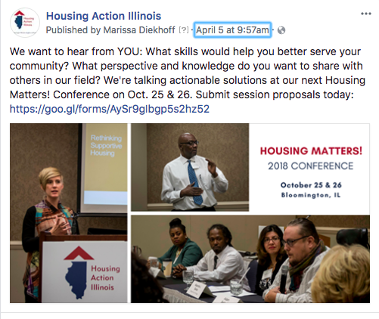
Social media do’s and don’ts
DO
Send them to your website!
DON’T
Set it and forget it

Slide 21
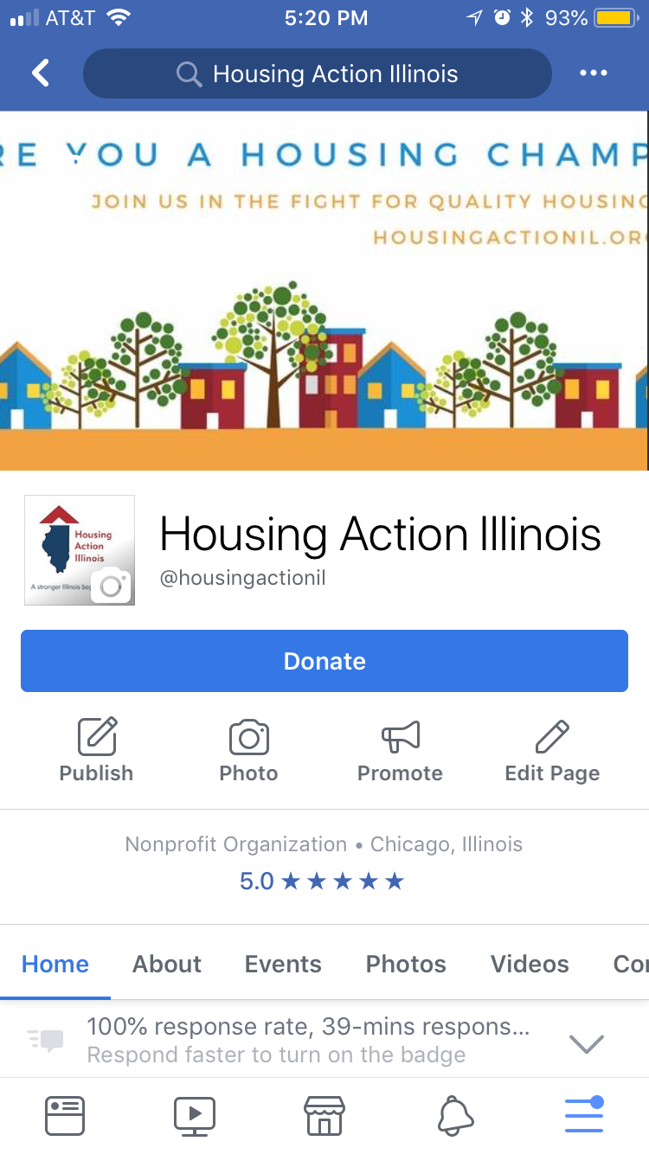
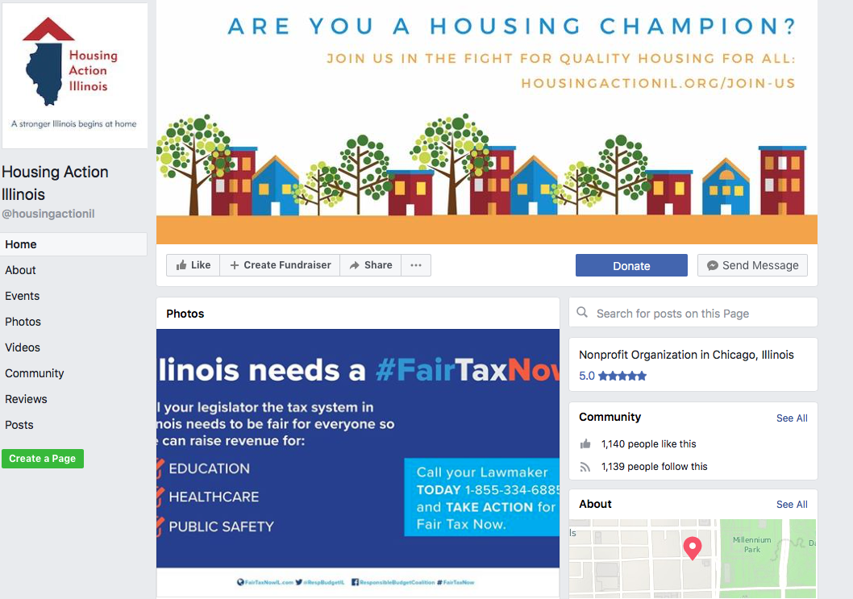
Social media do’s and don’ts
DO
Be mobile-friendly!
DON’T
Think about desktops only

Slide 22
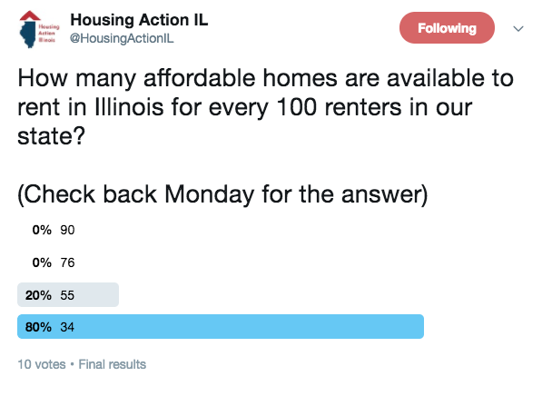
Social media do’s and don’ts
DO
Be engaging!
DON’T
Let them scroll past you

Slide 23
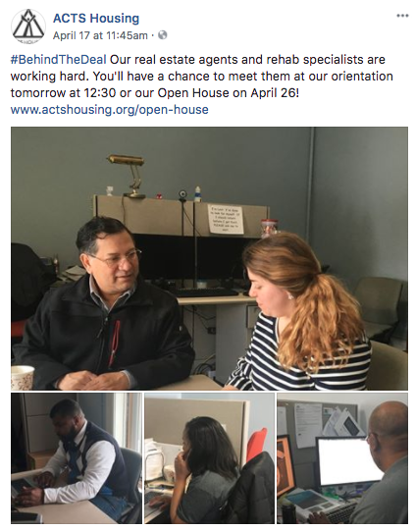
Social media do’s and don’ts
DO
Be engaging!
DON’T
Let them scroll past you

Slide 24
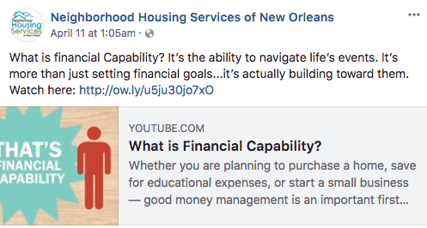
Social media do’s and don’ts
DO
Be engaging!
DON’T
Let them scroll past you

Slide 25
How many times should post a week?
Depends on who you ask!
M+R’s research says nonprofits post to Facebook 1.4 times/day and tweet 3.7 times a day
Another rule of thumb: no less than one, no more than two
Your target: 3 original posts per week
Part One
Why this matters
Part Two
Best Practices
Part Three
Advertising 101
Part Four
Taking Action

Slide 26
What should you post?
Two things to consider:
What is your main objective?
Who is your audience?
Review your business page
…or have me do it for you!
Part One
Why this matters
Part Two
Best Practices
Part Three
Advertising 101
Part Four
Taking Action

Slide 27
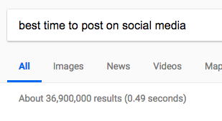
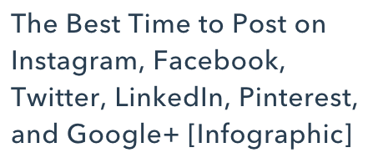
When should you post?
Part One
Why this matters
Part Two
Best Practices
Part Three
Advertising 101
Part Four
Taking Action

Slide 28
Questions?

Slide 29
Part III – Advertising 101

Slide 30
The importance of ads
Just 7% of your fans will see your posts* (M+R Benchmarks 2017)
*This does not include views from shares/retweets (which is good news)
38% of Facebook users who saw a given post were not already following the nonprofit (M+R Benchmarks 2018)
Part One
Why this matters
Part Two
Best Practices
Part Three
Advertising 101
Part Four
Taking Action

Slide 31
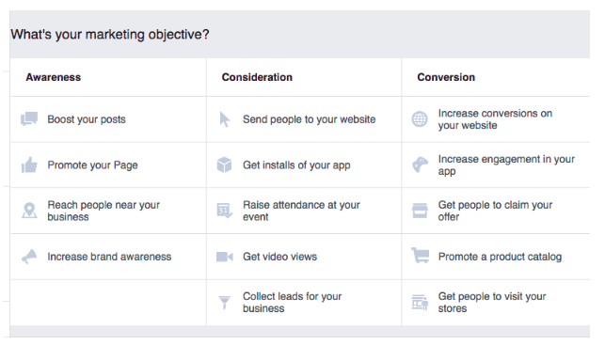
Eyes on the prize
Always have your goal in mind
Three types of campaigns:
Part One
Why this matters
Part Two
Best Practices
1.
2.
3.
Part Three
Advertising 101
Part Four
Taking Action

Slide 32
Types of campaigns
Awareness
Boosted posts
Promote your page
Increase organization awareness
Consideration
Send people to your website
Event registration
Part One
Why this matters
Part Two
Best Practices
Part Three
Advertising 101
Part Four
Taking Action

Slide 33
Why advertising makes sense for you
It’s inexpensive
It’s targeted
It’s effective
It’s a great way to mindlessly spend down your FPP-G dollars
Part One
Why this matters
Part Two
Best Practices
Part Three
Advertising 101
Part Four
Taking Action

Slide 34
Questions?

Slide 35
Part IV – Taking Action

Slide 36
Here’s what you can do right away
Download
Social Media Calendar
Social Media Planner
Social Media Review Checklist
Sample Social Posts
Email me!
Part One
Why this matters
Part Two
Best Practices
Part Three
Advertising 101
Part Four
Taking Action

Slide 37
Timm Krueger
timm@housingactionil.org
312.939.6074 x. 205
Notes:
Add icons for messaging 101, internal communications, communications and putting it all together; icons will change color when we’re talking about that topic

