Slide 1
YOU’VE GOT MAIL!
email marketing for housing counseling professionals
PRESENTATION BY TIMM KRUEGER | HOUSING ACTION ILLINOIS

Slide 2
SAVE THE DATE
Registration will open soon
You can use FPP-G training dollars for the conference!
PRESENTATION BY TIMM KRUEGER | HOUSING ACTION ILLINOIS

Slide 3
UPCOMING WEBINARS
JULY 24 STORYTELLING
AUGUST 21 PRINT MATERIALS
PRESENTATION BY TIMM KRUEGER | HOUSING ACTION ILLINOIS

Slide 4
TODAY’S AGENDA
BEST PRACTICES
GROWING YOUR LIST
NEWSLETTER TIPS
FUNDRAISING IDEAS
PRESENTATION BY TIMM KRUEGER | HOUSING ACTION ILLINOIS

Slide 5
MEET THE PRESENTER
TIMM KRUEGER | COMMUNICATIONS & MARKETING CONSULTANT
Five years industry experience
Executed 400+ marketing emails
I used to think in subject lines
HOUSING ACTION ILLINOIS
SMITHBUCKLIN
PEORIA HOUSING AUTHORITY
S&S PROPERTY MANAGEMENT
Email marketing is one of the most exciting, fun, and powerful tools we have to communicate with our target audience.
PRESENTATION BY TIMM KRUEGER | HOUSING ACTION ILLINOIS

Slide 6
BEST PRACTICES
PRESENTATION BY TIMM KRUEGER | HOUSING ACTION ILLINOIS

Slide 7
BEST PRACTICES
THINK MOBILE FIRST
We consume information differently on mobile devices than we do on desktops
Key term: Single column
55%
emails opened on mobile
MediaPost, 2017
PRESENTATION BY TIMM KRUEGER | HOUSING ACTION ILLINOIS

Slide 8
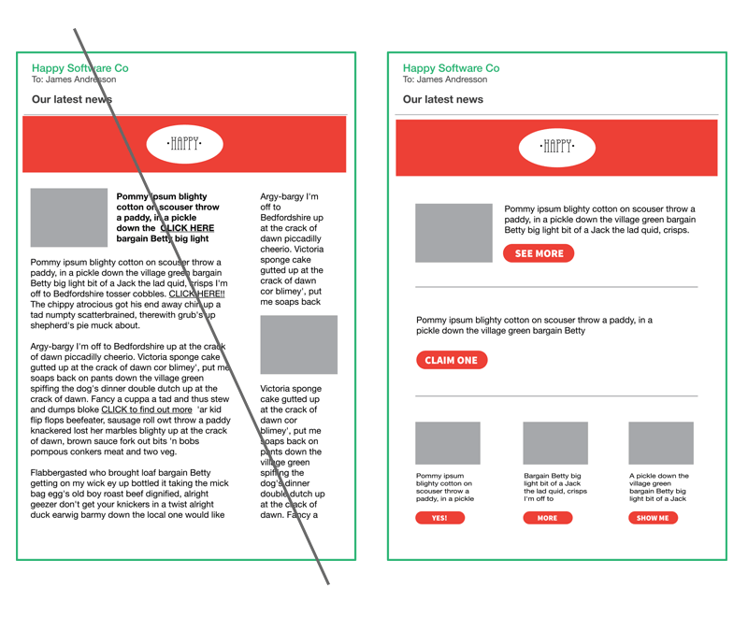
BEST PRACTICES
PRESENTATION BY TIMM KRUEGER | HOUSING ACTION ILLINOIS

Slide 9
BEST PRACTICES
LET’S GO OUT TO EAT
THE RESTAURANT
MAIN COURSE
DESSERT
SUBJECT LINE
BODY CONTENT
CALL-TO-ACTION
Email marketing is kind of like picking a restaurant for dinner.
PRESENTATION BY TIMM KRUEGER | HOUSING ACTION ILLINOIS

Slide 10
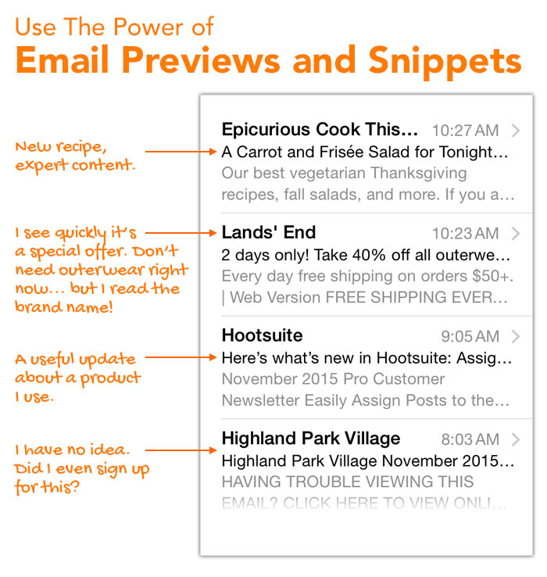
BEST PRACTICES
SUBJECT LINES
The most important part of your email
Keep it short, sweet, relevant
Few than 55 characters (10 words or less!)
Writing tip: Avoid spammy language, such as “FREE,” or exclamation points – they get caught by SPAM filters, and your emails might not get delivered.
PRESENTATION BY TIMM KRUEGER | HOUSING ACTION ILLINOIS

Slide 11
BEST PRACTICES
SUBJECT LINES
Key Term: Open rate
The number of people that open your email
What’s a good open rate for a nonprofit?
20%+
Writing tip: Be positive! Avoid words like “Don’t” in your subject lines – they turn readers away.
PRESENTATION BY TIMM KRUEGER | HOUSING ACTION ILLINOIS

Slide 12
BEST PRACTICES
PRE-HEADER
Summary of the body content
Again – short, sweet, relevant
Can increase your open rates!
PRESENTATION BY TIMM KRUEGER | HOUSING ACTION ILLINOIS

Slide 13
BEST PRACTICES
IMAGES
Always include images!
Ideal size: 600 x 200 px (width x height)
If 600 px overwhelms the email, try adding two images
Size: 600 x 200 px
Courtesy of Community Service Council
PRESENTATION BY TIMM KRUEGER | HOUSING ACTION ILLINOIS

Slide 14
BEST PRACTICES
BODY CONTENT
Less is more
Prioritize images and video
Put links in words/images
Don’t forget your CTA!
Courtesy of Heartland Alliance
PRESENTATION BY TIMM KRUEGER | HOUSING ACTION ILLINOIS

Slide 15
BEST PRACTICES
BODY CONTENT
Less is more
Prioritize images and video
Put links in words/images
Don’t forget your CTA!
Courtesy of Heartland Alliance
PRESENTATION BY TIMM KRUEGER | HOUSING ACTION ILLINOIS

Slide 16
BEST PRACTICES
CALLS-TO-ACTION (CTA)
PRESENTATION BY TIMM KRUEGER | HOUSING ACTION ILLINOIS

Slide 17
BEST PRACTICES
MAIN TAKEAWAYS
Keep your text short and sweet
Send people to your website
Think about how it’ll look on a phone or tablet
Have one main focus and drive it home
PRESENTATION BY TIMM KRUEGER | HOUSING ACTION ILLINOIS

Slide 18
GROWING YOUR LIST
PRESENTATION BY TIMM KRUEGER | HOUSING ACTION ILLINOIS

Slide 19
GROWING YOUR LIST
STARTING OUT
Don’t just get their email address
First and last name
Client, supporter, or volunteer?
Areas of interest (counseling, classes, newsletter, etc.)
Key term: Segment
PRESENTATION BY TIMM KRUEGER | HOUSING ACTION ILLINOIS

Slide 20
GROWING YOUR LIST
ON YOUR WEBSITE
PRESENTATION BY TIMM KRUEGER | HOUSING ACTION ILLINOIS

Slide 21
GROWING YOUR LIST
SOCIAL MEDIA
Cross promote!
When you send an email, post about it on social media
Include a link to your sign-up
Facebook makes it easy
PRESENTATION BY TIMM KRUEGER | HOUSING ACTION ILLINOIS

Slide 22
GROWING YOUR LIST
OTHER IDEAS
At events (paper/electronic)
Email signature
Printed newsletter
Get your board involved
Wi-Fi incentive
Lobby sign-up form
PRESENTATION BY TIMM KRUEGER | HOUSING ACTION ILLINOIS

Slide 23
NEWSLETTER TIPS
PRESENTATION BY TIMM KRUEGER | HOUSING ACTION ILLINOIS

Slide 24
NEWSLETTER TIPS
BE CONSISTENT
Pick a name
Pick a day (week, month, quarter)
Stick to it!
PRESENTATION BY TIMM KRUEGER | HOUSING ACTION ILLINOIS

Slide 25
NEWSLETTER TIPS
THINK DESIGN
Single column
Image-driven
White space
Minimal colors
PRESENTATION BY TIMM KRUEGER | HOUSING ACTION ILLINOIS

Slide 26
NEWSLETTER TIPS
THINK DESIGN
Single column
Image-driven
White space
Minimal colors
PRESENTATION BY TIMM KRUEGER | HOUSING ACTION ILLINOIS

Slide 27
NEWSLETTER TIPS
THINK DESIGN
Single column
Image-driven
White space
Minimal colors
PRESENTATION BY TIMM KRUEGER | HOUSING ACTION ILLINOIS

Slide 28
NEWSLETTER TIPS
THINK DESIGN
Single column
Image-driven
White space
Minimal colors
PRESENTATION BY TIMM KRUEGER | HOUSING ACTION ILLINOIS

Slide 29
NEWSLETTER TIPS
CONTENT
Add value
Update them on your work
Tell a story
Real images, not stock
Writer’s block? Outsource it!
PRESENTATION BY TIMM KRUEGER | HOUSING ACTION ILLINOIS

Slide 30
NEWSLETTER TIPS
CONTENT
Add value
Update them on your work
Tell a story
Real images, not stock
Writer’s block? Outsource it!
PRESENTATION BY TIMM KRUEGER | HOUSING ACTION ILLINOIS

Slide 31
NEWSLETTER TIPS
CONTENT
Add value
Update them on your work
Tell a story
Real images, not stock
Writer’s block? Outsource it!
PRESENTATION BY TIMM KRUEGER | HOUSING ACTION ILLINOIS

Slide 32
NEWSLETTER TIPS
CONTENT
Add value
Update them on your work
Tell a story
Real images, not stock
Writer’s block? Outsource it!
PRESENTATION BY TIMM KRUEGER | HOUSING ACTION ILLINOIS

Slide 33
NEWSLETTER TIPS
CONTENT
Add value
Update them on your work
Tell a story
Real images, not stock
Writer’s block? Outsource it!
PRESENTATION BY TIMM KRUEGER | HOUSING ACTION ILLINOIS

Slide 34
FUNDRAISING IDEAS
PRESENTATION BY TIMM KRUEGER | HOUSING ACTION ILLINOIS

Slide 35
FUNDRAISING IDEAS
HOW LONG WOULD YOU STAY FRIENDS WITH SOMEONE WHO ONLY TALKED TO YOU WHEN THEY NEEDED $20?
Question courtesy of CauseVox
PRESENTATION BY TIMM KRUEGER | HOUSING ACTION ILLINOIS

Slide 36
FUNDRAISING IDEAS
WHY EMAIL IS IMPORTANT
28%
$42
38%
EMAIL MESSAGING DROVE 28% OF ALL ONLINE REVENUE IN 2017
FOR EVERY 1,000 EMAILS SENT, NONPROFITS RAISED $42
38% OF ONLINE DONORS IN 2016 DONATED AGAIN IN 2017
From M+R Benchmarks 2017: “You can expect that a substantial majority of your first-time donors this year, the ones you worked so hard to acquire, will not return to make a second gift next year. But those who do, those who renew their commitment to your cause, are more likely to come back again and again.”
PRESENTATION BY TIMM KRUEGER | HOUSING ACTION ILLINOIS

Slide 37
FUNDRAISING IDEAS
QUALITY AND QUANTITY
The size and quality of your list is the most important factor in raising money online
Less like a funnel, more like a mountain
Cost vs. Value
PRESENTATION BY TIMM KRUEGER | HOUSING ACTION ILLINOIS

Slide 38
FUNDRAISING IDEAS
CONTENT STRATEGY
Strategy tip: Be consistent
Strategy tip: It’s a marathon, not a sprint
PRESENTATION BY TIMM KRUEGER | HOUSING ACTION ILLINOIS

Slide 39
FUNDRAISING IDEAS
CONTENT
Thank
Update
Invite
Ask
EXAMPLE NEEDED
PRESENTATION BY TIMM KRUEGER | HOUSING ACTION ILLINOIS

Slide 40
FUNDRAISING IDEAS
CONTENT IDEAS
Writing tip: Appeal to your supporter’s sense of empathy
Writing tip: Use real words – talk to them like they’re a friend
PRESENTATION BY TIMM KRUEGER | HOUSING ACTION ILLINOIS

Slide 41
FUNDRAISING IDEAS
RESOURCES
Anatomy of an Email
Email Calendar and Report
Email Tip Sheet, Glossary
Customizable Email Graphics
CTA Buttons
Sample Email Campaign Strategy
Sample Subject Lines
PRESENTATION BY TIMM KRUEGER | HOUSING ACTION ILLINOIS

Slide 42
THANK YOU
Timm@HousingActionIL.org
PRESENTATION BY TIMM KRUEGER | HOUSING ACTION ILLINOIS

Slide 43
CITATIONS
cloche by Yazmin Alanis from the Noun Project
Chicken by Xela Ub from the Noun Project Cake by Dumitriu Robert from the Noun Project
PRESENTATION BY TIMM KRUEGER | HOUSING ACTION ILLINOIS

Slide 44
ONE IMAGE AND COMPARISON
Consequently, this entails simply selling an already existing product, and using promotion techniques to attain the highest sales possible.
PRESENTATION BY TIMM KRUEGER | HOUSING ACTION ILLINOIS

Slide 45
GRAPHIC CHART
USES A SALES ORIENTATION FOCUSES PRIMARILY ON THE SELLING PROMOTION
Selling promotion of a particular product. Consequently, this entails simply selling an already existing product, and using promotion techniques to attain the highest sales possible.
TITLE ONE
A firm employing a product orientation is mainly.
PRESENTATION BY TIMM KRUEGER | HOUSING ACTION ILLINOIS

Slide 46
01
WRITE HERE YOU TITLE
YOU CAN WRITE SOMETHING HERE
PRESENTATION BY TIMM KRUEGER | HOUSING ACTION ILLINOIS

Slide 47
COMPANY NUMBERS
25%
10%
65%
WRITE TITLE
WRITE TITLE
WRITE TITLE
The term 'marketing concept' pertains.
The term 'marketing concept' pertains.
The term 'marketing concept' pertains.
Consequently, this entails simply selling an already existing product, and using promotion techniques to attain the highest sales possible.
PRESENTATION BY TIMM KRUEGER | HOUSING ACTION ILLINOIS

Slide 48
WRITE HERE YOUR TITLE
A firm using a sales orientation focuses primarily on the selling promotion of a particular product, and not determining new consumer desires as such. Consequently, this entails simply selling an already existing product, and using promotion techniques to attain the highest sales possible.
15%
WRITE TITLE
The term 'marketing concept' pertains to the fundamental premise.
PRESENTATION BY TIMM KRUEGER | HOUSING ACTION ILLINOIS

Slide 49
Free Icons
Use the ”Shape Fill” Option to change the color of the icons.

Slide 50
Free Icons
Use the ”Shape Fill” Option to change the color of the icons.

